Slide 1
Reception Curriculum Meeting

Slide 2
What we will cover:
The Early Years Foundation Stage Curriculum
How we teach reception children at Woodloes
Jolly Phonics
Mathematics Mastery
How you can support at home

Slide 3
The Early Years Foundation Stage Curriculum
Develop curiosity and enthusiasm for learning
Crucial in order to develop skills in the specific areas
Three prime areas
Personal, Social and Emotional Development
Communication and Language
Physical Development
Four specific areas
Literacy
Maths
Understanding the World
Expressive Arts and Design

Slide 4
The Early Years Foundation Stage Curriculum (EYFS)
The EYFS is the stage of education from birth to the end of their reception year
It recognises that children learn best through play and active learning
Characteristics of effective learning
Playing and exploring
Active learning
Creating and thinking critically

Slide 5

The Early Years Foundation Stage Curriculum (EYFS)
There are17 areas of the EYFS curriculum.
This document is designed for parents to understand in more detail about the 17 areas of learning.

Slide 6
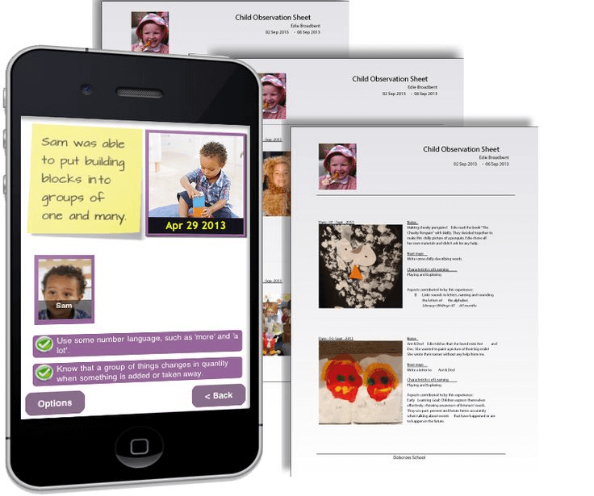
The Early Years Foundation Stage Curriculum (EYFS)
The environment and provision is based on your child’s needs and interests
We teach the children whilst they are playing
We also observe the children and take notes and photographs on what they can do making links to objectives in the EYFS
2simple
Mark making books
Learning journals
Notes:
iPods
Accessed during stay and play sessions

Slide 7
Local Area Visits
To enhance the curriculum delivery and encourage personal development, we may take the children out on local area visits.
These will be:
Within short walking distance from school
Staffed according to Warwickshire guidelines
Incur no cost
Always fall within the normal school hours
We will not seek consent for each local area visit but will send a courtesy note (when possible) to inform you in advance that one is planned.

Slide 8
Jolly Phonics
Children learn to read and write through a systematic programme called Jolly Phonics
Learn the main 42 sounds of English
The first term will be spent learning the letter sounds and names.
One letter sound is taught each day.
s, a, t, i, p, n
c k, e, h, r, m, d
g, o, u, l, f, b
ai, j, oa, ie, ee, or
z, w, ng, v, oo, oo
y, x, ch, sh, th, th
qu, ou, oi, ue, er, ar

Slide 9

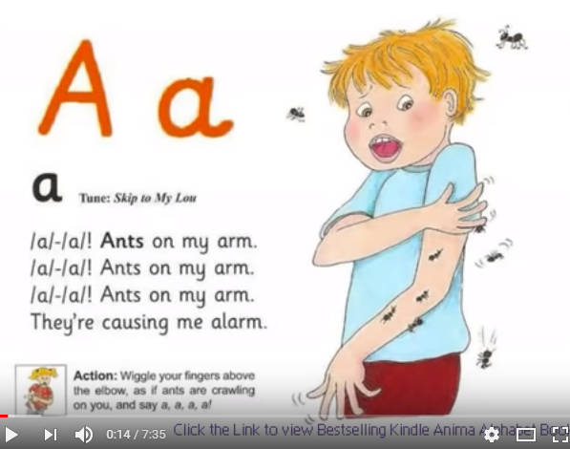
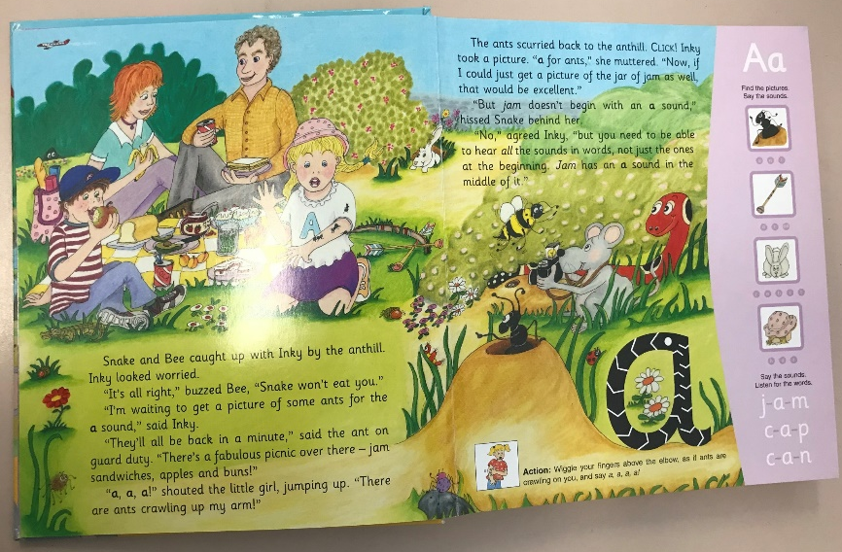
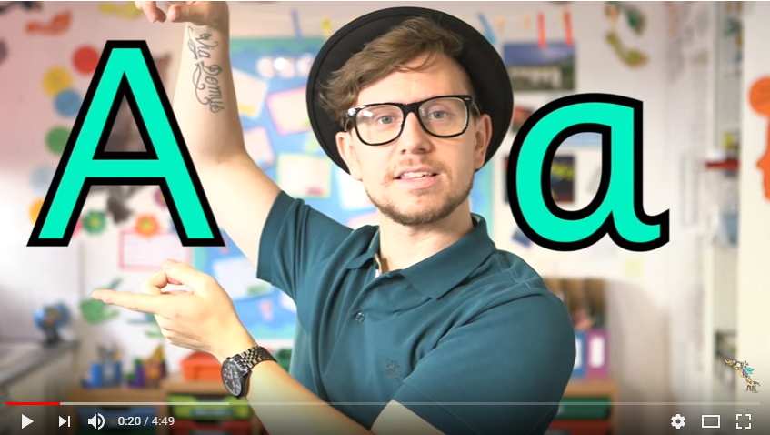
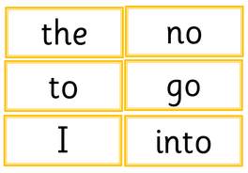
Revisit
Letter formation
S
Song
a
Teach
Story and action
Tricky words
Mr Thorne does phonics

Slide 10
Start with singular sounds
Progress onto digraphs
Digraphs are where two letters make one sound e.g. ‘sh’ or ‘ch’
The ‘oo’ and ‘th’ digraphs are initially introduced in two sizes. The children learn that they each make two different sounds, as in ‘book’ and ‘moon’

Slide 11
Blending sounds for reading
Most words can be broken down into individual sounds.
e.g.
c a t
If a word has a digraph in it then it is blended like this:
s h i p

Slide 12
Tricky words
Some words cannot be sounded out by reading the sounds.
the
she
my

Slide 13
Segmenting for spelling
Segmenting is separating a word into its original sounds
e.g.
d o g
To help with segmenting, we use robot arms.

Slide 14
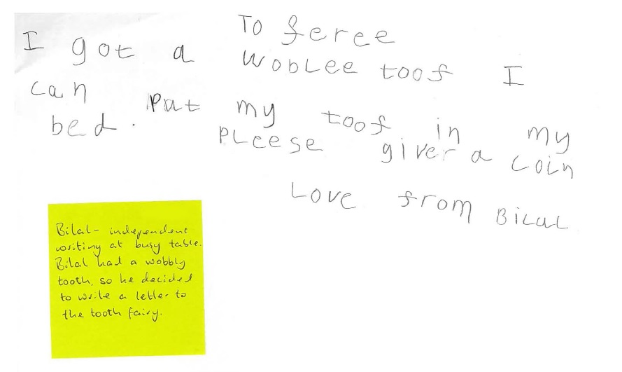
Segmenting for spelling
Expected level of writing by the end of reception:

Slide 15
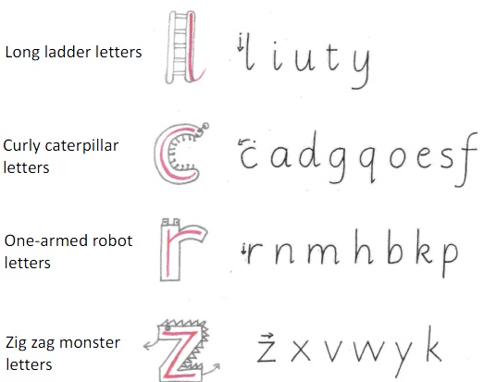
Letter formation
Letter formation is taught alongside the sounds
The children learn the ‘froggy legs’ grip
The groups below show how the letters should be formed.

Slide 16

What you can do at home
Practise sounds daily
Read as often as possible (3/4 times a week)
- Record reading in the reading record book
-Books are in the classroom for children to change
-Active Learn Bug Club login (login will be in reading diary) to access online books (login – my stuff – open books)
Helpful tips for reading at home:
Point to each word (magic finger) and encourage him / her to do the same.
Discuss the setting / characters – encourage your child to relate events to real-life experiences.
Encourage sounding out of letters and learning to blend sounds – practice, practice, practice !!!
Recap the story, encourage correct sequencing of the story.

Slide 17
What you can do at home
Practise writing their name using their name card, encouraging correct pencil grip and letter formation
Practise blending and segmenting orally as well as for reading and writing
Practise reading and spelling tricky words
Helpful tips for writing at home:
Write shopping lists
Write letters to family members or fictional characters e.g. the tooth fairy
Write cards
Chalks/water paintbrushes

Slide 18
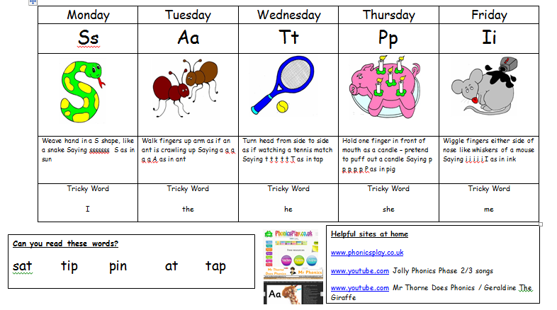
We will send home a weekly sheet, including sounds, jolly phonic actions and tricky words to your child practise.

Slide 19
Finally …
At home, remember little and often!
Your child may be tired after school but don’t worry. It’s better to leave it, than to push too hard.
Remember, effort on your part, at this stage, is worth it.

Slide 20

Mathematics Mastery

Slide 21
What is Maths Mastery?
Fewer topics in greater depth
Mastery for all pupils
Number sense and place value come first
Problem solving is central

Slide 22
What does the National Curriculum say?
“Pupils who grasp concepts rapidly should be challenged through being offered rich and sophisticated problems before any acceleration through new content.”
“Those who are not sufficiently fluent should consolidate their understanding, including through additional practice, before moving on.”

Slide 23
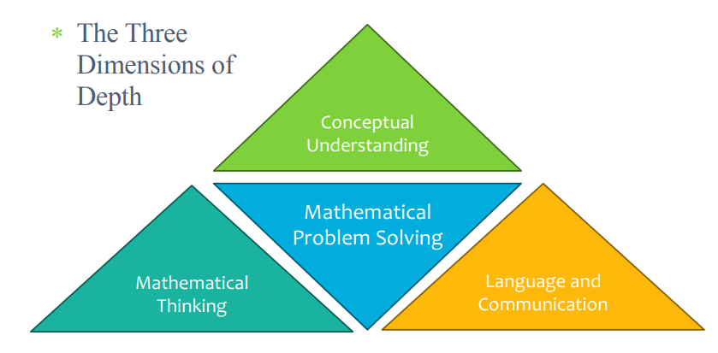

Slide 24
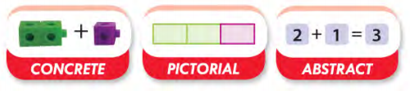
Conceptual Understanding
Represent concepts using objects and pictures
Reaches out to a variety of learners
Concrete allows discovery
Pictorial allows conceptual understanding
Abstract allows a shorted and more efficient way to represent numerical ideas using symbols.

Slide 25
Mathematical Thinking
Pupils deepen their understanding by:
giving an example
sorting or comparing
looking for patterns and rules

Slide 26
Language and Communication
Mathematics Mastery lessons provide opportunities for pupils to communicate and develop mathematical language through:
Sharing essential vocabulary at the beginning of every lesson and insisting on its use throughout
Modelling clear sentence structures using mathematical language
Paired language development activities, known as Talk Tasks.
Plenaries which give a further opportunity to assess understanding through pupil explanations.

Slide 27
What does a Maths lesson look like?
Maths meetings every morning – days of the week, months, weather, number of children.
Do now (consolidate prior learning).
New learning (big picture, star words, using full sentences, model talk task).
Talk task (working in pairs with manipulatives to investigate new learning).
Resources in the environment.
This keeps the lesson pacey, gives flow and allows more opportunities to teach creatively, give feedback and assess learning.
Pupils have access to plenty of concrete materials such as bead strings and place value counters so that they have time to fully explore mathematics.

Slide 28


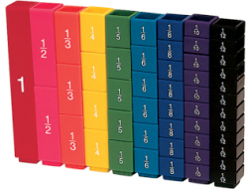

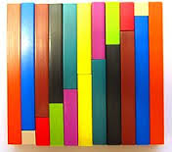
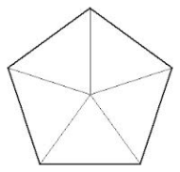

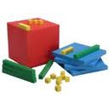
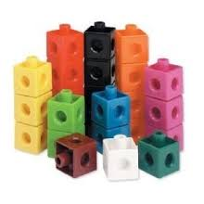
What do concrete resources look like?
Bead strings
Bar models
Fraction towers
100 grids
Number lines
Cuisenaire rods
Shapes
Dienes blocks
Multilink cubes
Notes:
These are some examples of materials that can be used at the “concrete” and “pictorial” stages to support students at all levels of attainment to access mathematics and deepen their understanding.

Slide 29
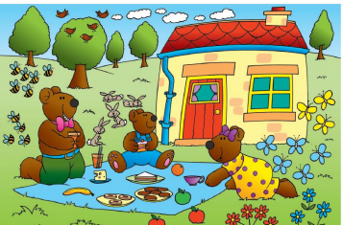
Big Pictures
Each unit starts with a big picture. This provides opportunities to:
engage children
relate maths to real life applications
Make connections
Promote and develop pupil reasoning
“3 bears”
“There are three bears in the picture”
“I can see 3 yellow butterflies and 5 blue butterflies. There are 8 butterflies all together.”

Slide 30
How can I become involved?
Talk to your child about their learning, what they learn in their maths lessons each day.
Discuss numbers all around you: door numbers, bus numbers etc.
Encourage your child to predict what number will come next in a sequence of door numbers – are they odd or even?
Cooking and shopping with your child, getting them to weigh ingredients, using language such as “more” and “less/fewer”.
Encourage your child to talk in ‘full sentences’.
Use Mathletics at home (login is in reading diary)

Slide 31
Thank you for listening.
Any questions?

