Slide 1
Phonics Monday 12th July

Slide 2
When we write in a pre cursive style, we have to start on the line. Here is an example below:

Slide 3
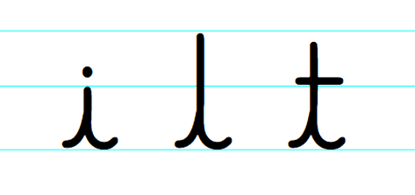
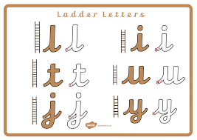
All 3 of these letters will start on the line, go up like a ladder and then end with a small flick.

Slide 4
1. Can you practise these letters on some lined paper? Please write one line of each letter.
Notice the height of the ‘i’ compared to the ascending ‘l’ and ‘t’.
Are your letters the right height?

Slide 5
2. Write these three words, using the pre cursive style for the letters and .
s
Is your ‘p’ a descender (does it go below the line)?
p

Slide 6
3. Write a sentence using one of the words, you could write my sentence or one of your own.
I
s
n
Do you have a capital letter at the start of your sentence? A full stop at the end?
he
p
.

