Slide 1
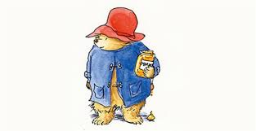
Welcome to the Year 3 Curriculum

Slide 2
Year 3 Staff
3C Teachers
Mr Clark
Miss Matu
3G Teacher
Miss Goodrick
Year 3 Teaching Assistants
Mrs Dyson
Mrs Furlong
Miss Day

Slide 3
National Curriculum 2014
The children continue to learn the full range of National Curriculum subjects with a focus upon English and Maths.
Maths and Science are specific for Year 3
Foundation subjects have content and assessment specific to Year 3.

Slide 4
Year 3 Topics
Autumn a | Autumn b | Spring a | Spring b | Summer a | Summer b
Stone Age Boy | Message in a Bottle | Rotten Romans | This is London… | Leon and the place between | Where my wellies take me

Slide 5
English
English consists of Speaking and Listening, Reading and Writing.
Talk is the starting point for all learning and we use ‘Talk Partners’ and Kagan groups to develop talk within the classroom.
We use Bloom’s Taxonomy to ensure that we ask a variety of questions to get children thinking and talking.

Slide 6
Reading
We teach reading through daily reading opportunities.
Whole class reading, group guided sessions, individual reading and class books.
There is a shift away from word reading skills to a focus upon comprehension and understanding. Therefore many of the reading sessions will be discussions of language, meaning, inferring and vocabulary extension.

Slide 7
Accelerated Reader
AR is used to support independent reading and home-reading.
The children complete a Star Reading test
This gives the children a ZPD (zone of proximal development) which is a range of books to read independently with the right amount of challenge.
Books in the shared area are labelled according to AR book levels and the children are guided on which books to choose. WARNING!
Quizzes – once the children have read the book, they complete a short quiz of 5 or 10 questions which enables us to know if they have read with understanding.
https://ukhosted64.renlearn.co.uk/2249453/

Slide 8
Parents and Accelerated Reader
Home Connect https://ukhosted64.renlearn.co.uk/2249453/HomeConnect/
You can log into this web page to see which books your child has read and how they are doing in the quizzes
You can use : www.arbookfind.co.uk a public search engine to find books that are on AR

Slide 9
Writing
Year 3 Writing is linked to the topic or theme usually through an excellent book that we use as a starting point e.g. Stone Age Boy.
Each half term we do blocks of work on narrative, poetry and non-fiction genres.
Grammar, Spelling and Punctuation (GPS) is taught as a stand alone subject throughout the week.

Slide 10
Maths in Year 3
We follow the new National Curriculum brought out in 2014.
Year 3 has its own programme of study, as do other year groups.
In some areas the content is significantly more demanding than in the past.
A greater focus on mental arithmetic and on working with fractions.

Slide 11
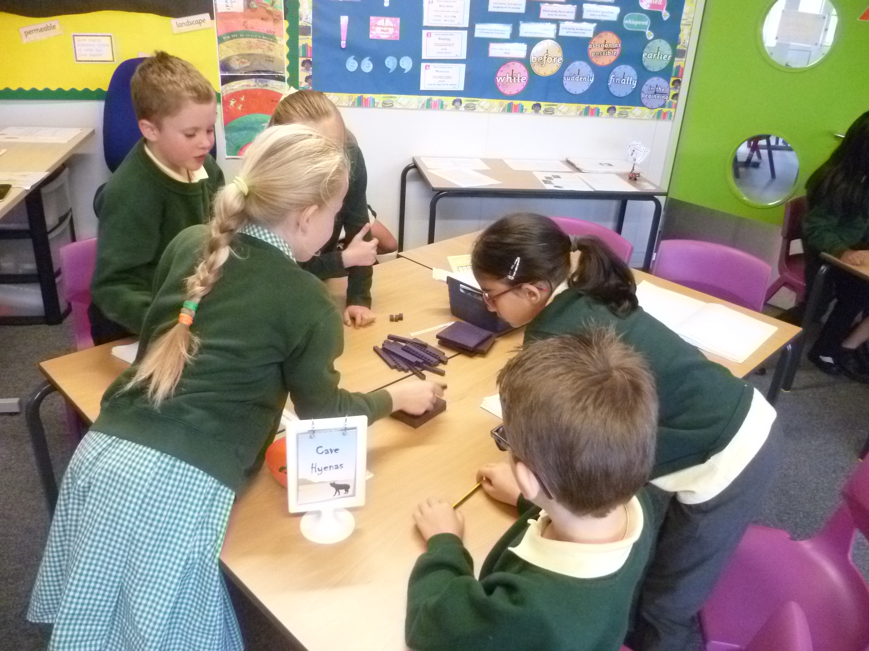
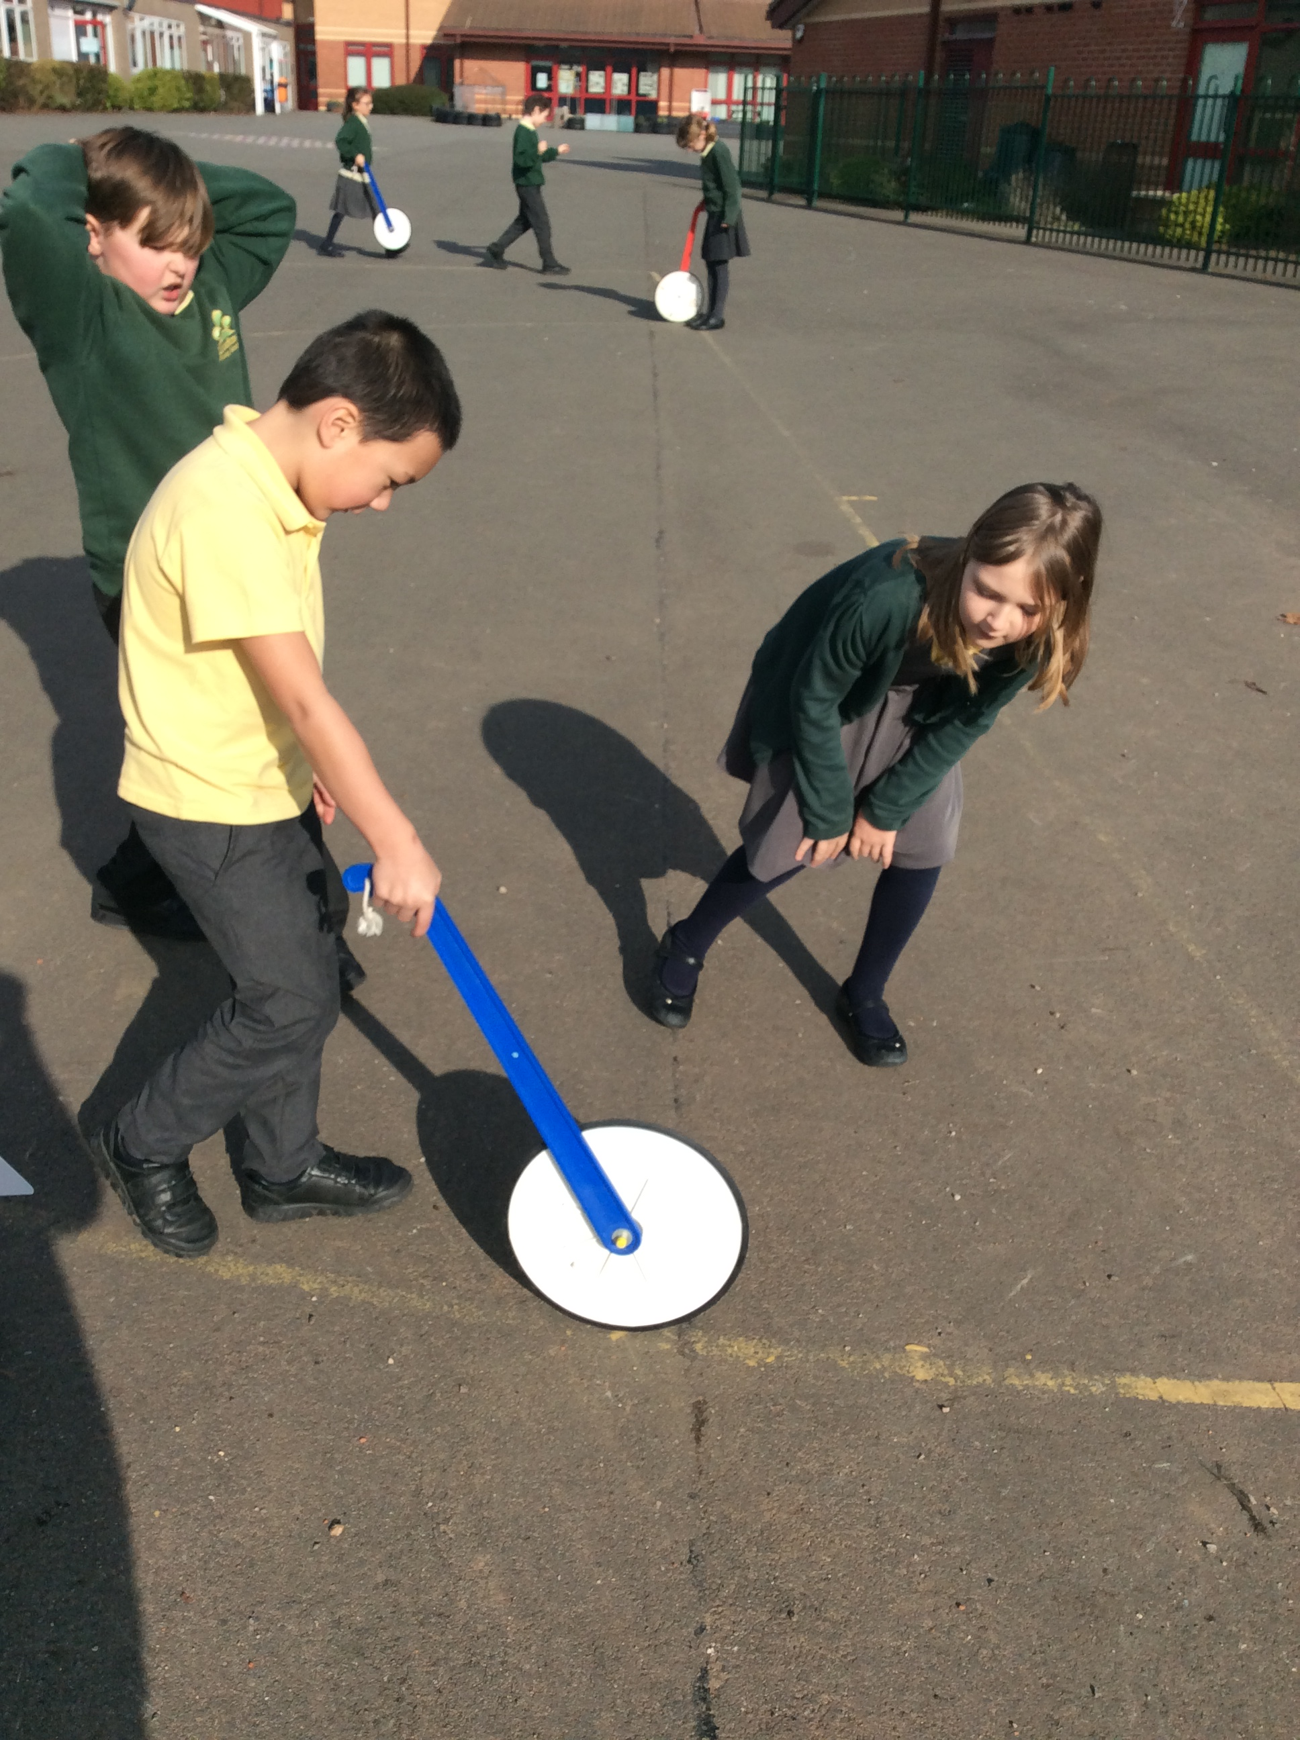
Main Themes
Number and place value - up to 1000
Addition and subtraction - up to 3 digits
Multiplication and division
X tables from Y2 plus x3 x4 and x8
Related division facts (instant recall)
2 digit x 1 digit using a formal written method
Fractions – of objects and numbers
Measurement – compare, add and subtract measures
Geometry – properties of 2D & 3D shapes, right angles, turns and lines
Statistics – presenting data, bar charts, pictograms and tables

Slide 13
Why should we do the 6-part Maths lesson?
To provide regular opportunities for children to consolidate their understanding through discussion and practise.
Simplified WALTs (focussing on one concept) enable children to grasp one concept before another one is introduced.
To ensure that children understand a concept (e.g. place value) thoroughly before they use and apply it.

Slide 14
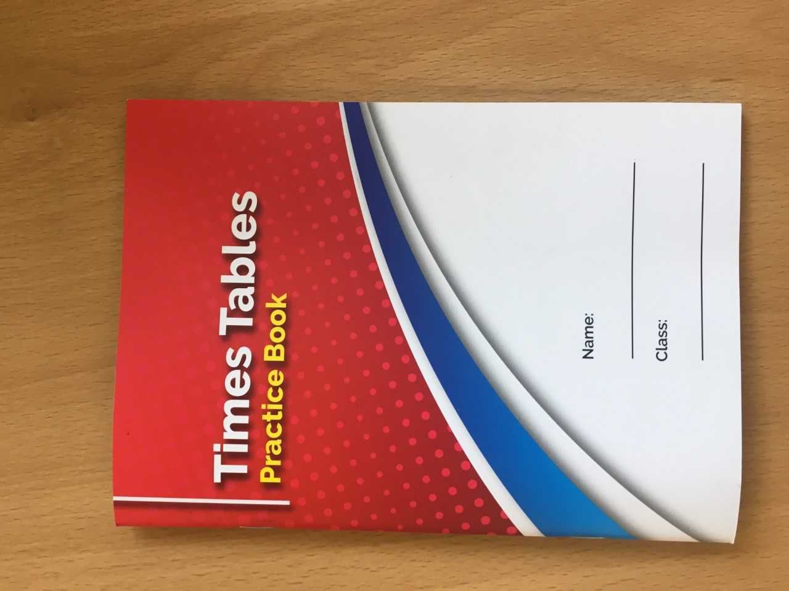
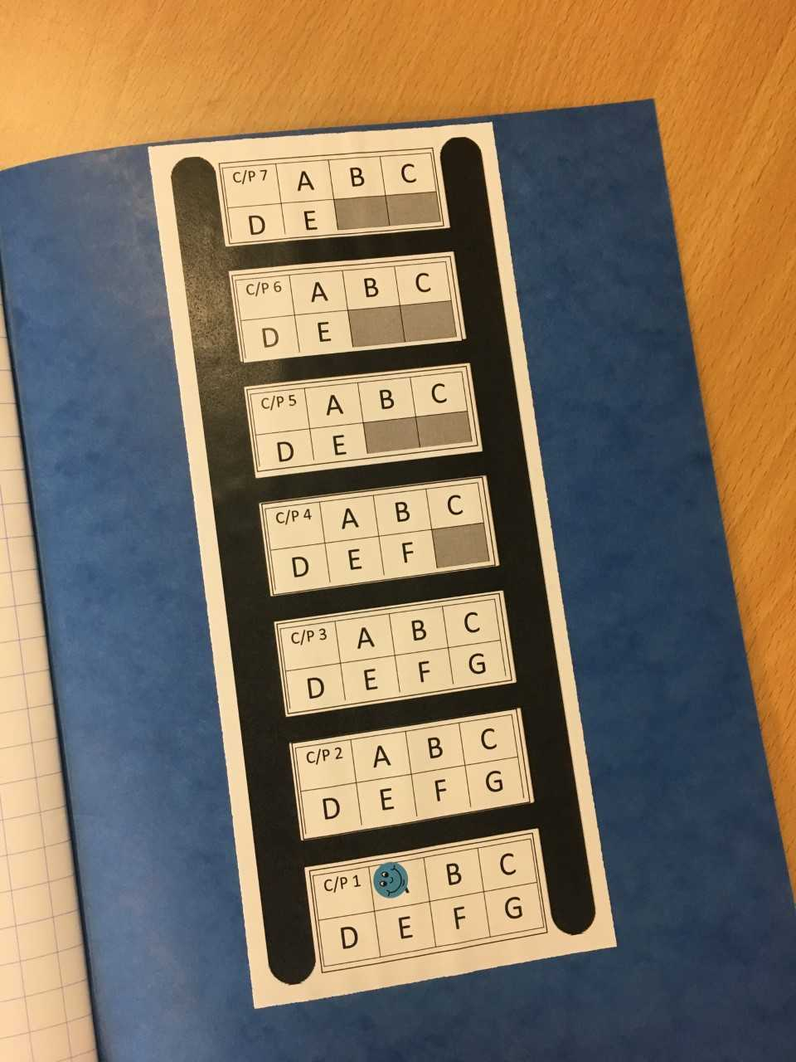
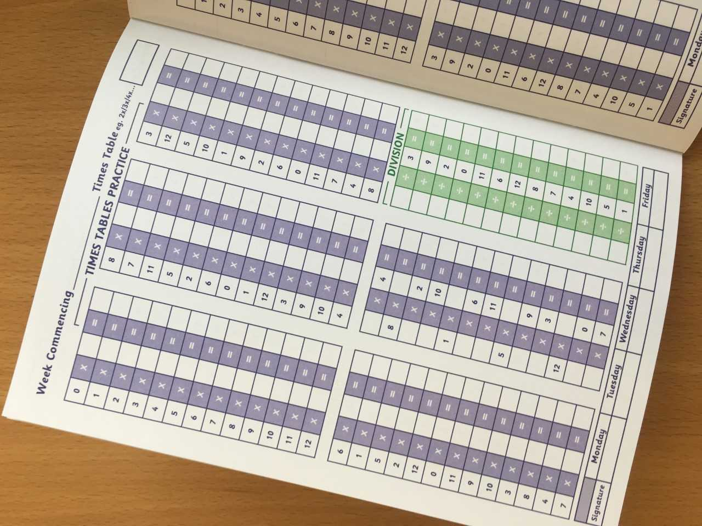
Times Tables
Y2 - x2, x5, x10
Y3 - those above plus x3, x4 and x8
Checkpoint Challenge

Slide 15
Formal Written Methods
“It’s not like when I was at school….”

Slide 16
Assessment

Slide 17
If your child is not Year 3 ready, then they will access their targets through Year 2 or the most appropriate year group programme.
If your child is achieving well, rather than moving on to the following year group’s work we will encourage more in-depth and investigative work to allow a greater mastery and understanding of concepts and ideas.

Slide 18
Typical Day

Slide 19
Local Area Visits
To enhance curriculum delivery and encourage personal development, we may take the children on out on local area visits.
These will be:
Within short walking distance from school
Staffed according to Warwickshire guidelines
Incur no cost
Always fall within the normal school hours
We will not seek consent for each local area visit but will send a courtesy note (when possible) to inform you in advance that one is planned.

Slide 20
Home-Learning Overview
Reading and sharing stories as often as possible at home.
Working to achieve at least 15 minutes a day.
Weekly times-table practice.
Frequent spelling practice.
Weekly Mathletics.
English and / or Maths task linked to the learning from the present week.

Slide 21
Thank you for coming!
Any questions?

