Slide 1
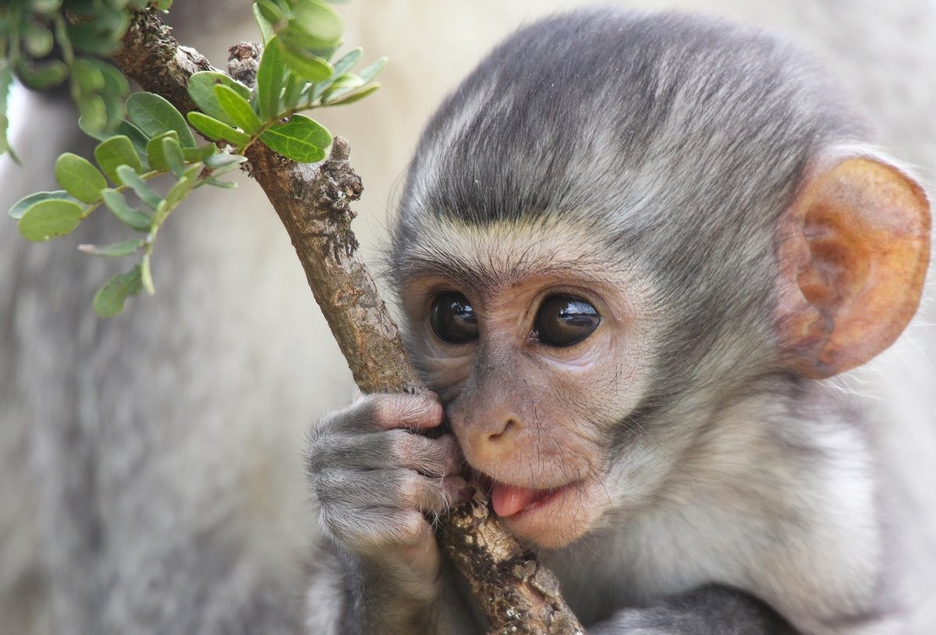
Mammals
WALT: write a non chronological report. Wk beg 18th January
.
.

Slide 2
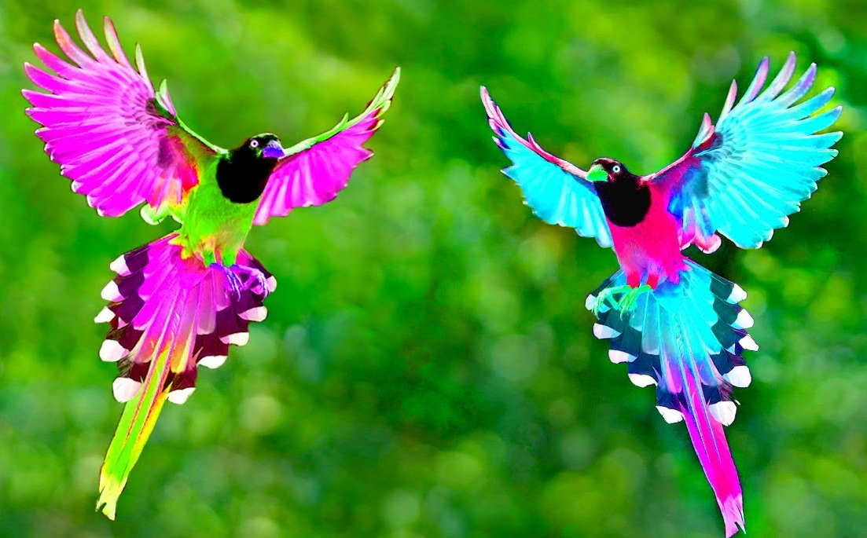
Birds
WALT: write a non chronological report. Wk beg 18th
.
.

Slide 3
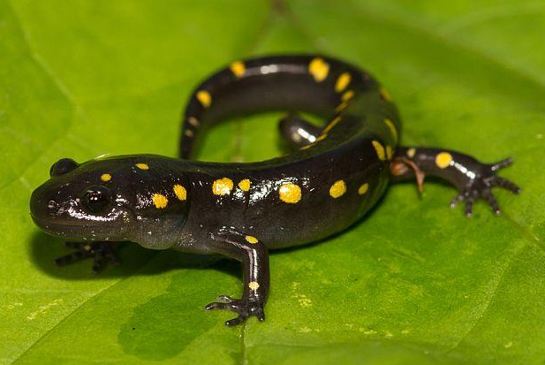
amphibians
WALT: write a non chronological report. Wk beg 18th
.
.

Slide 4
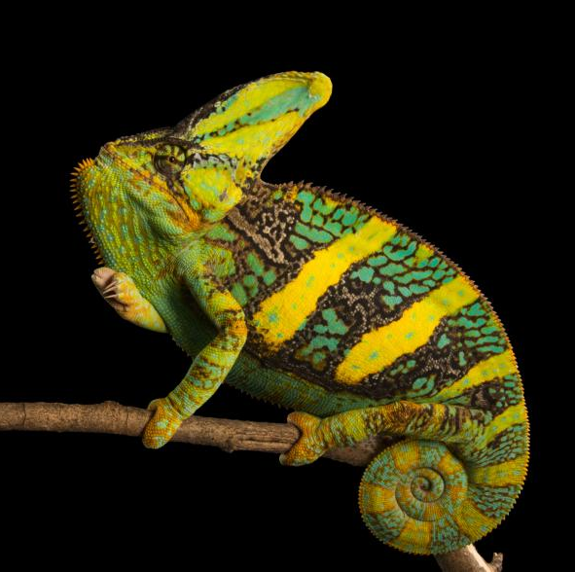
Reptiles
WALT: write a non chronological report. Wk beg 18th
.
.

