Slide 1
11:12:20​
WALT Use the Formal Written Method of Subtraction F R PS
Remember to draw a margin on each page.
Remember to leave a space between each question.
Remember to write the sub-heading Fluency.

Slide 2
Vocabulary take away minus subtraction formal written method columns borrow digits thousands hundreds tens ones Th H T O one digit in one square
​

Slide 3
Daily 10
Practise of number bonds to 10 or 20
https://www.topmarks.co.uk/maths-games/daily10

Slide 4
https://www.youtube.com/watch?v=Fwu5pNNAi7s&t=18s
Watch this video to remind you how to do the written formal method of subtraction. Start the video at the time 5:11

Slide 5
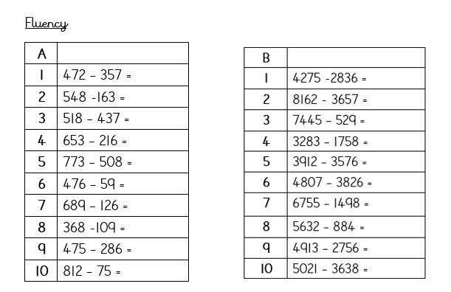

Slide 6
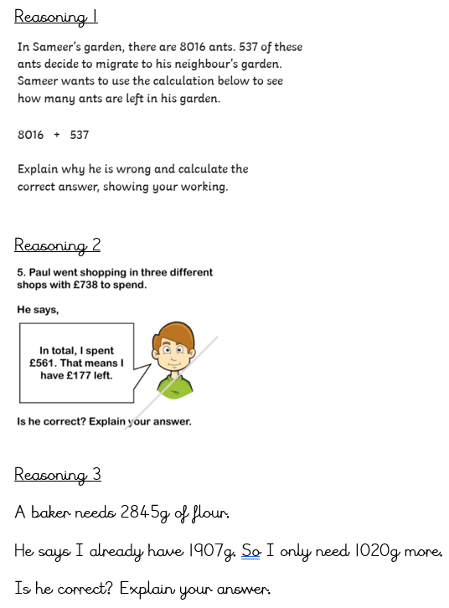

Slide 7
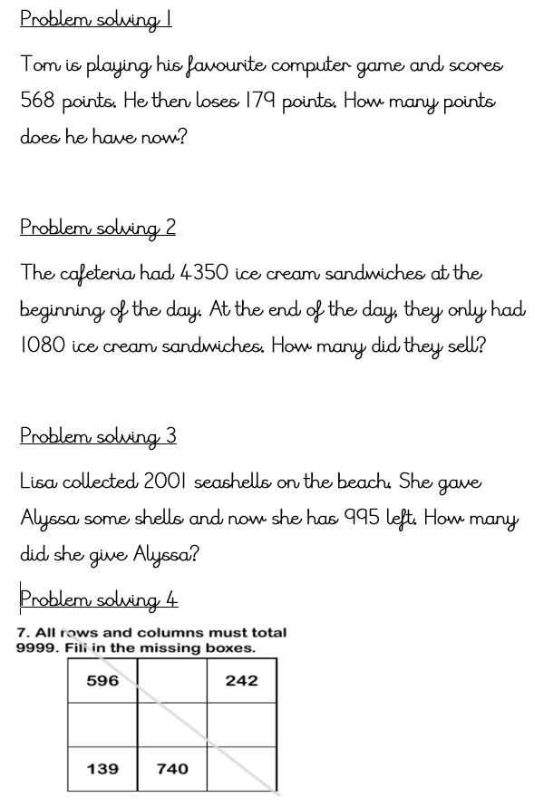

Slide 8
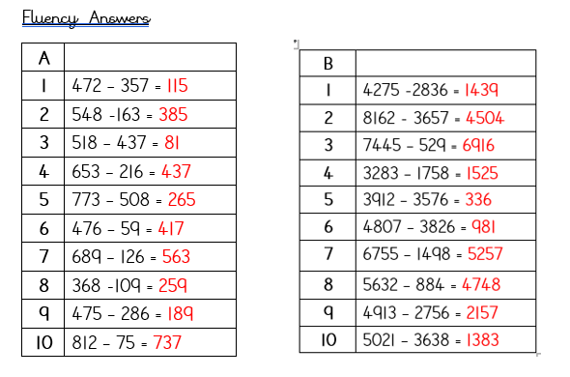

Slide 9
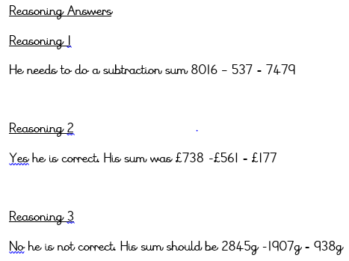

Slide 10
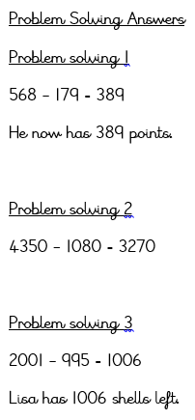
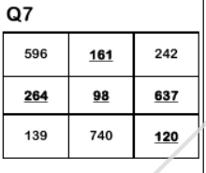
Problem solving 4 answer

