Slide 1

Welcome to Woodloes
Introductory Reception Parents’ Meeting
Thursday 30th June

Slide 2
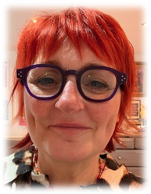
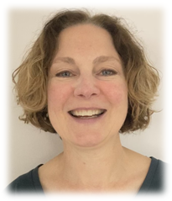
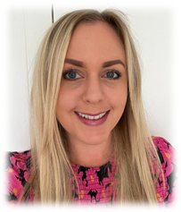
Reception Staff:
Justine Valentine – Early Years Phase Leader
Clare Magnall, Sophie Bailey – Class Teacher
Teaching assistants TBC

Slide 3
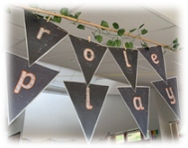
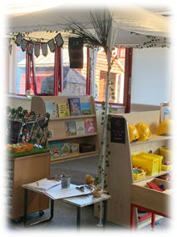
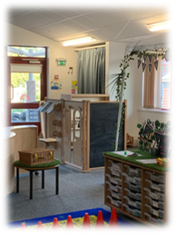
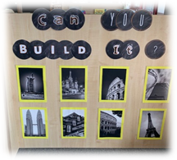
Reception at Woodloes
We operate in one open plan setting with two designated areas for taking the register and delivering whole class input, mainly phonics, reading and maths.
The teachers work closely together to ensure consistency for the cohort.

Slide 4
Classes
We have created two classes: RV and RMB.
There is a list to tell you which class your child is in.
Class RV’s stay and play date in Wednesday 6th July
Class RMB’s stay and play date is Thursday 7th July
We know some people requested specific dates but this is a set date for your child so they can meet the rest of their class at the same time. It was impossible for us to co ordinate everybody’s requests unfortunately.

Slide 5



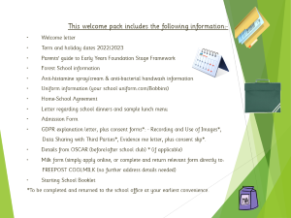
This welcome pack includes the following information:-
• Welcome letter
• Term and holiday dates 2022/2023
• Parents’ guide to Early Years Foundation Stage Framework
• Forest School information
• Anti-histamine spray/cream & anti-bacterial handwash information
• Uniform information (your school uniform.com/Bobbins)
• Home-School Agreement
• Letter regarding school dinners and sample lunch menu
• Admission Form
• GDPR explanation letter, plus consent forms*: - Recording and Use of Images*,
Data Sharing with Third Parties*, Evidence me letter, plus consent slip*.
• Details from OSCAR (before/after school club) * (if applicable)
• Milk form (simply apply online, or complete and return relevant form directly to:
FREEPOST COOLMILK (no further address details needed)
• Starting School Booklet
*To be completed and returned to the school office at your earliest convenience.

Slide 6
The New Curriculum
The New National Curriculum for Reception is an extension of the learning the children will have been doing in their nursery settings.
Children will follow a play-based curriculum that allows them to learn in a variety of practical ways with a mix of teacher led learning and child led learning.
A Parent guide to the EYFS curriculum is enclosed in your pack.

Slide 7
Transition from Nursery
We have spoken to and/or visited and/or received transition notes from almost all of the nurseries.
We have visited settings and have sent photos of our school and staff to support any talk of ‘big school’ with your children.

Slide 8
Introductory Play Session
The sessions are
Wednesday 6th July 3:30pm – 4:15pm RV
Thursday 7th July 3:30pm – 4:15pm RMB
This is an opportunity for your children to see all the staff who will be working in Reception. It allows the children to explore the classroom, both inside and outside so they can begin to find their way around.
We expect you to stay with your child for this session. We think it may be too overwhelming for some children if you don’t. Please limit yourselves to two adults per child.

Slide 9
Summer holidays – preparing your child
We have provided you with a ‘starting school booklet’ in your green folder.
Please take time to complete this booklet with your child gradually over the summer holiday.
It is essential that your child can dress and undress independently in preparation for PE lessons (including clothes that are inside out and buttons).
Please support your child so that they can use a knife and fork independently.
We would also expect all children to be able to go to the toilet by themselves.
If you have any concerns about this please don’t hesitate to speak to us at the end.

Slide 10

September Week 1
w/b 05/09/22 - Home visits
Home visits – first week in September between Tuesday and Friday.
This is a worthwhile and valuable experience for you (parents), us (teachers) and for your children.
It provides you with an opportunity to talk to us and ask questions and we are able to give you important dates and other vital pieces of information.
Your home visit appointment will be emailed to you.

Slide 11

September Week 2
w/b 12.09.22 - The First Week in school (part time)
Children attend three sessions in the first week:
Monday 12th September RV in morning 8:45 - 12:00
Tuesday 13th September RMB in morning 8:45 – 12:00
Wednesday 14th September RV in afternoon 1:00 – 3:15pm
Thursday 15th September RMB in afternoon 1:00 – 3:15pm
Friday 16th September both classes in 8:45 – 1:00pm children to stay for lunch
This is a ‘getting to know each other’ time and the emphasis is on having fun.

Slide 12
September Week 3
w/b 19/09/22 - The Second week in school (full time)
Children start full time between 8:45 - 3.15

Slide 13

Things your child will need
Children do not need any equipment such as pencils as we provide everything. The only things that you will need to provide are:
a named water bottle (which will go home each night to be washed)
a named PE kit in a bag
a named Forest school all-in-one puddle suit
a school book bag with their name on the card
We do not wish the children to bring items or objects from home unless they have been invited for ‘show and tell’ by the class teacher.

Slide 14
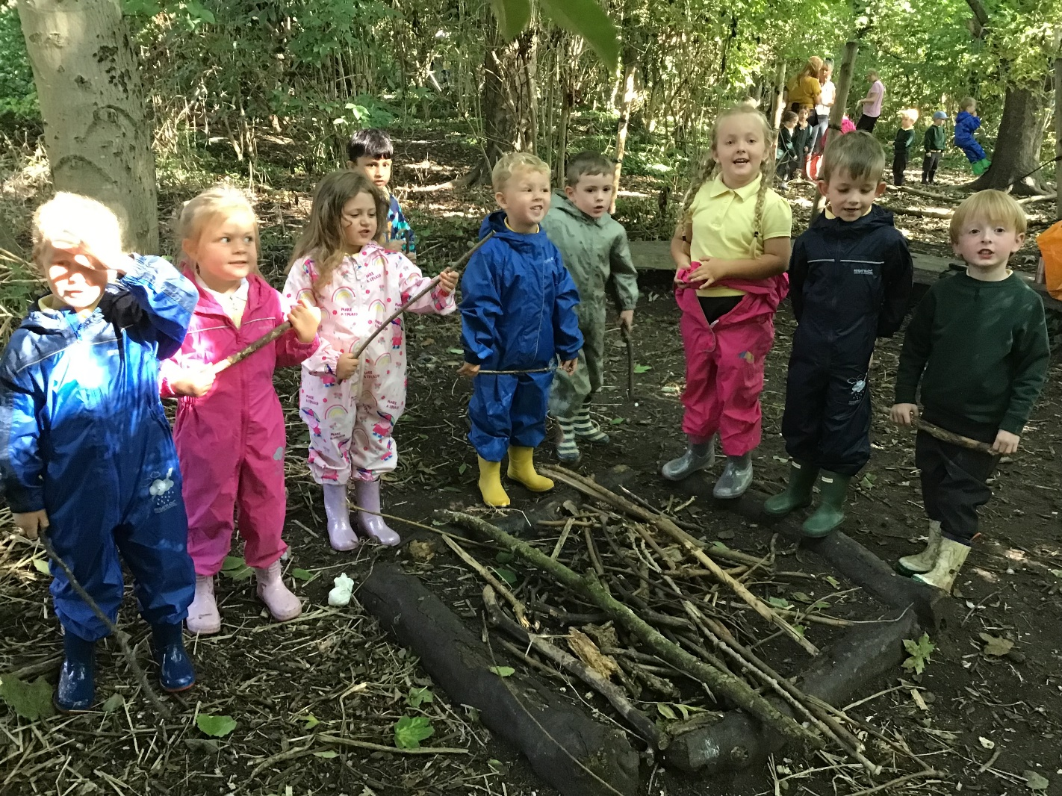
For Forest School learning activities we strongly recommend that children wear an all in one, hooded, waterproof suit which can be worn over their school uniform with a pair of wellington boots.
Please name everything the children bring in to school.

Slide 15

Stay and Play Sessions
3 sessions for each class through the academic year. One per term.
Allows adults (parents/grandparents) and children, the chance to play together in the reception setting
See how your child is learning through play and what types of learning opportunities your child experiences at school
We will give you the dates of all of the ‘Stay and Play’ sessions at the beginning of September so that you can hopefully make the necessary arrangements well in advance to be able to join us for these fun sessions!

Slide 16
The First Half-Term
This is a ‘settling in’ time in order for the children to form new relationships and learn the routines of school life. This involves getting used to:
The register
Lunchtime in the hall
The length of the school day
P.E and Forest School
Rules and routines of the day
A baseline assessment will be carried out on your child in compliance with the new National Curriculum.
We will hold a ‘Jolly Phonics’ / Curriculum evening early in September to enable us to provide you with important information about how we will be teaching phonics to the children.

Slide 17
Thank you for listening!
We welcome any questions …
?

