Slide 1
Year 1
Virtual Learning Activities

Slide 2
Year 1’s daily virtual learning menu
Don’t forget to visit the power point called ‘Help at Home’ or drop us an email if you need help.

Slide 3
Spelling Lists
How’s your spelling coming on? Are you practising a few words each day?

Slide 4
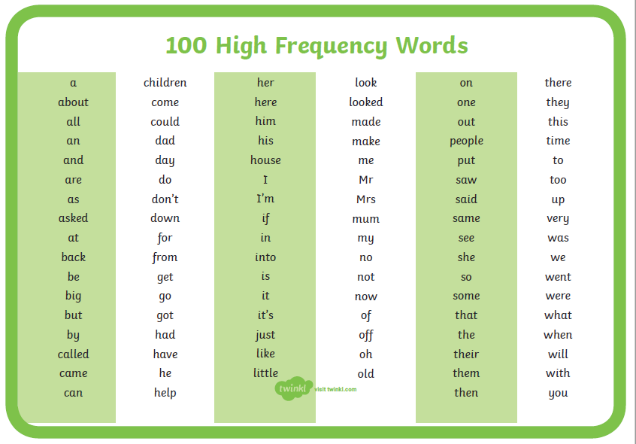

Slide 5
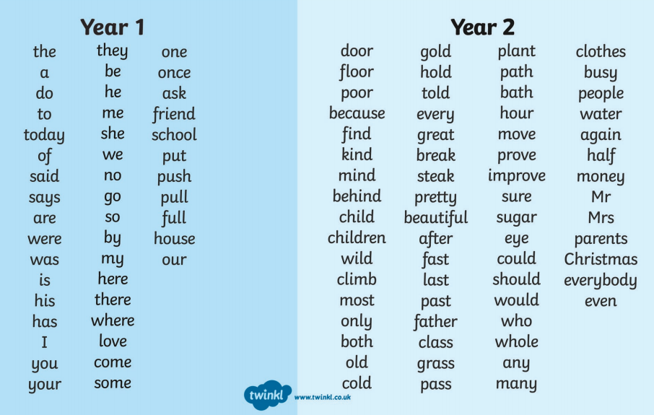

Slide 6
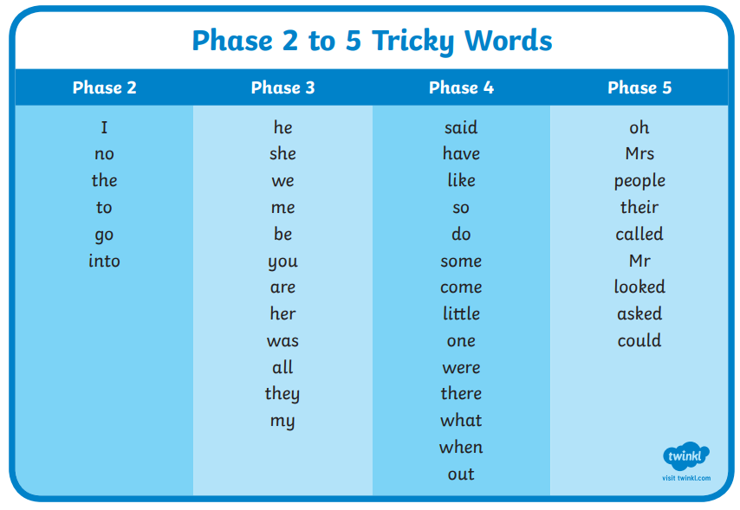

Slide 7
Topic based activities

Slide 8
In addition to your daily learning, you need to do at least one additional task each day:
Can you keep a tally chart of people you see exercising in one day? You need to say what they were doing: running, walking, riding a bike. An extension would be to turn this information into a pictogram.
Make a list of all the things in your bedroom make of plastic.
Draw a picture of the seaside and label all the things you have drawn.
Count in 5’s to 100 once everyday. Can you do it backwards?
Find out about another town or city in England with a castle.
Write about your favourite book, tell us why you like it.
Find things around the house that rhyme like: cat and hat, sock and clock
Can you find out the names of trees near your house? The shape of the leaves will help you.

Slide 9
Monday 20th April 2020

Slide 10
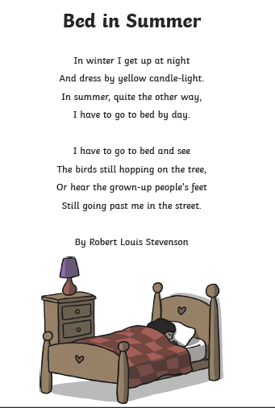
English task
(Reading comprehension)
Read the poem and then answer the questions about the story.

Slide 11
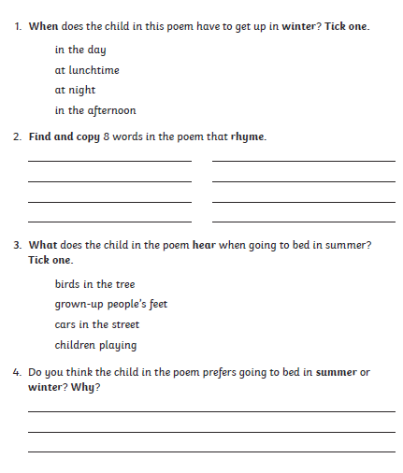
English task

Slide 12
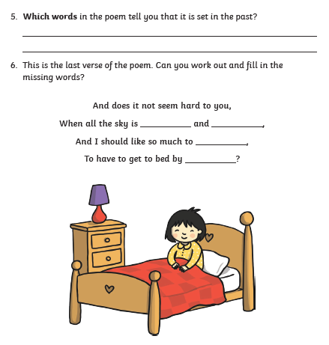
English task
(Reading comprehension)

Slide 13
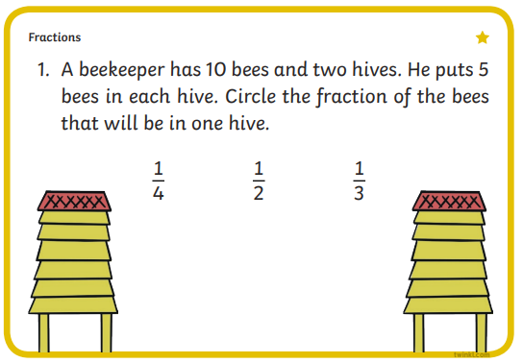
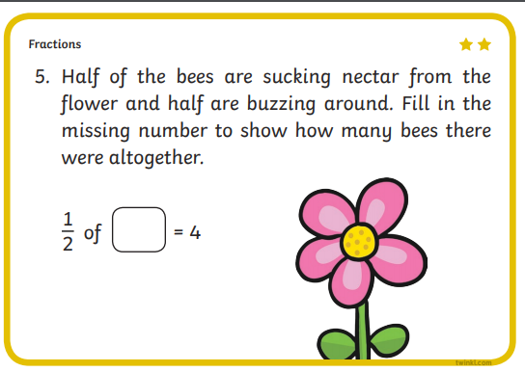
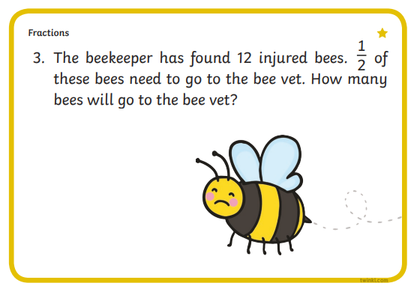
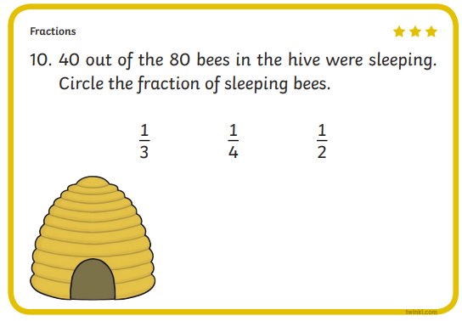
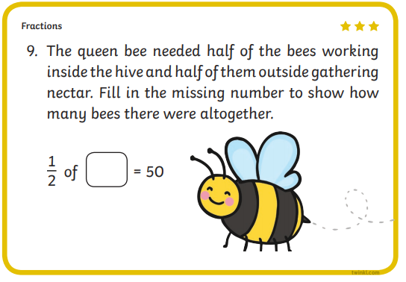
Maths task

Slide 14
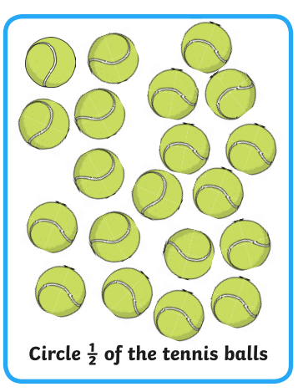
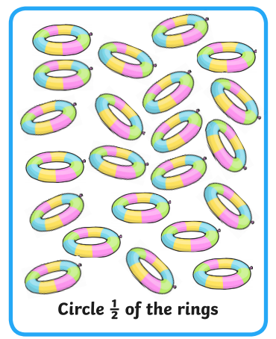
Maths task

Slide 15
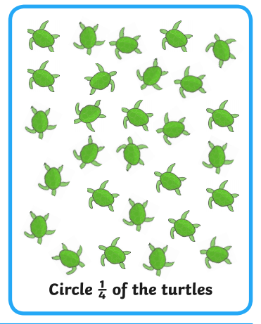
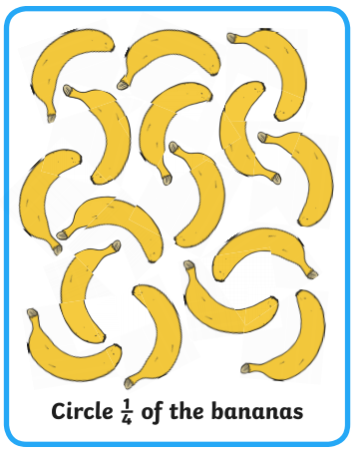
Maths task

Slide 16
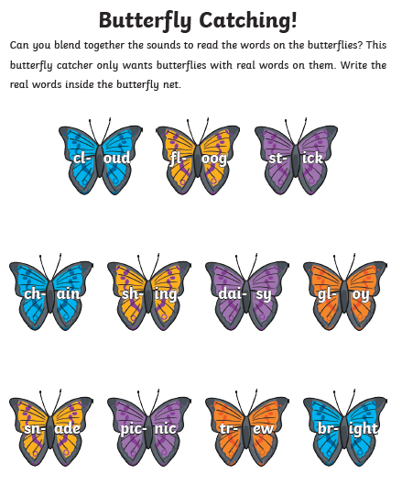
Phonics
(Next page)

Slide 17
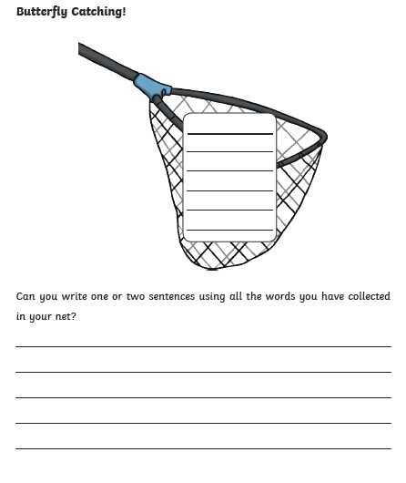
Phonics

Slide 18
Tuesday 21st April 2020

Slide 19
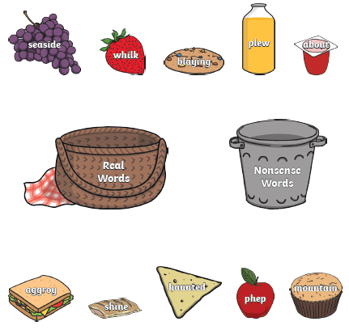
English – Writing Activity
Can you read aloud the words on the picnic and decide if they are real or nonsense words?
Then can you write sentences using the real words?

Slide 20
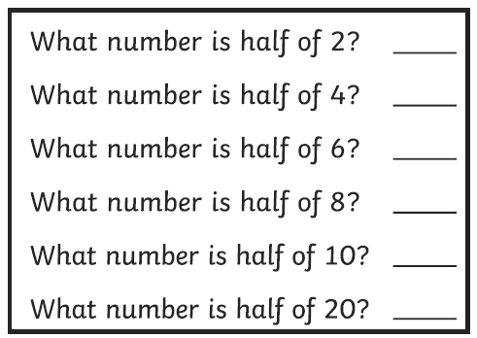
Maths task

Slide 21
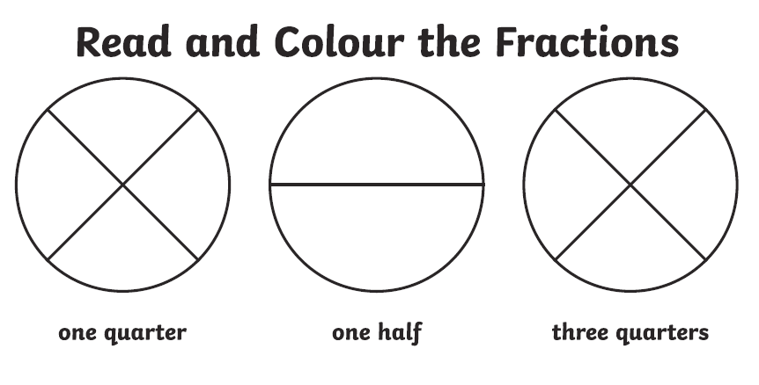
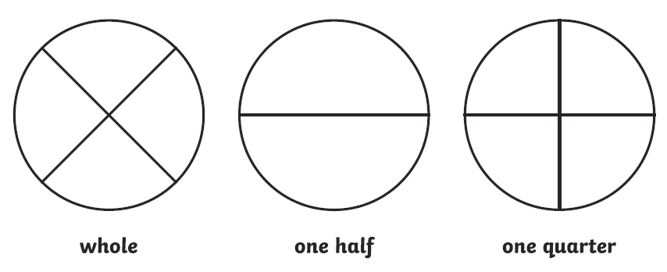

Slide 22
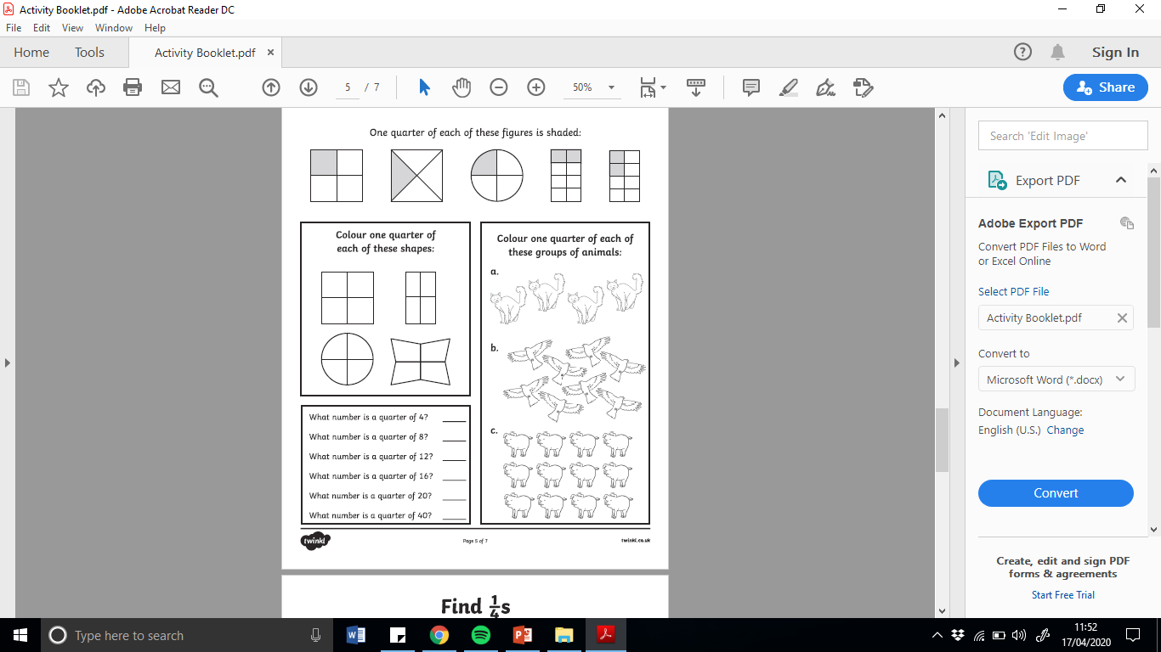
Maths task

Slide 23
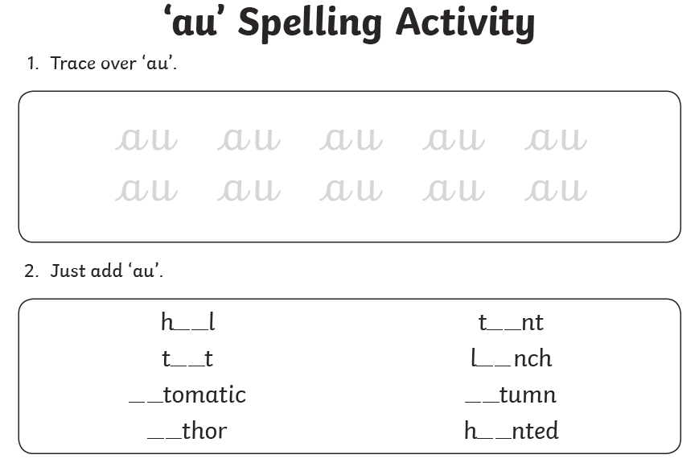
Phonics
Can you use these words in sentences?

Slide 24
Wednesday 22nd April 2020

Slide 25
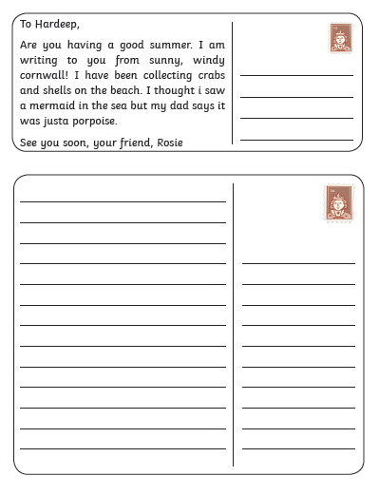
English task
Can you rewrite the post card and correct all the mistakes?
Look for capital letters
Full stops
spellings

Slide 26
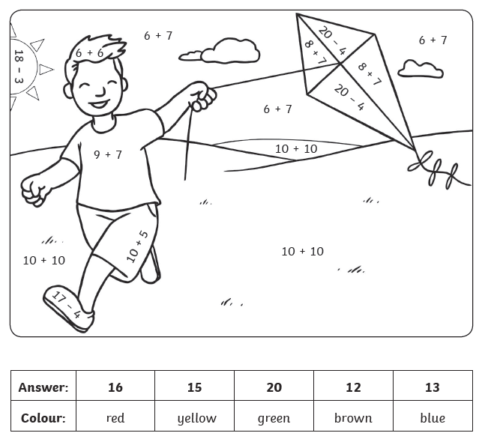
Solve the equations and colour in the summer picture.
Can you make up equations of your own to match the colours?
7 + 8 = yellow
Challenge →

Slide 27
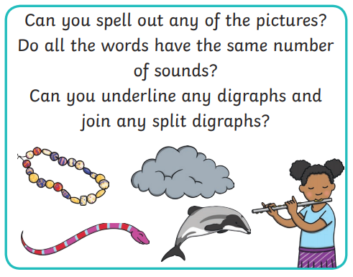
Phonics
Use the words in sentences.

Slide 28
Thursday 23rd April 2020

Slide 29
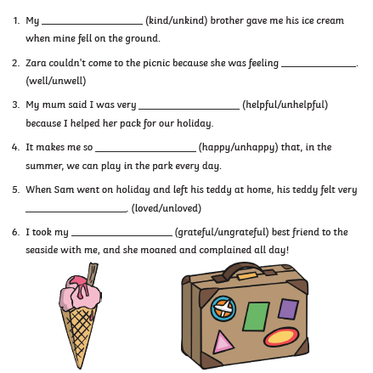
English
Write out the sentences putting the correct word in the space.

Slide 30
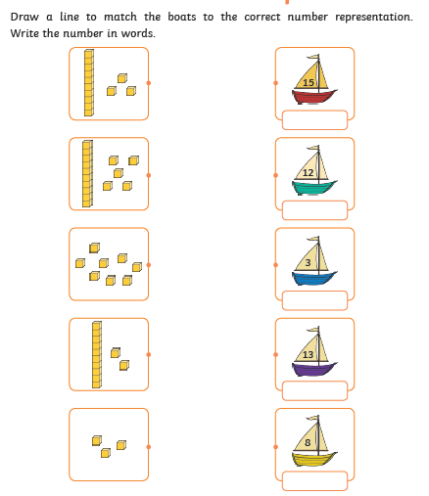
Maths task
To challenge yourself:
Can you write the numbers in words?
Can you write and solve 2 equations using these numbers?

Slide 31
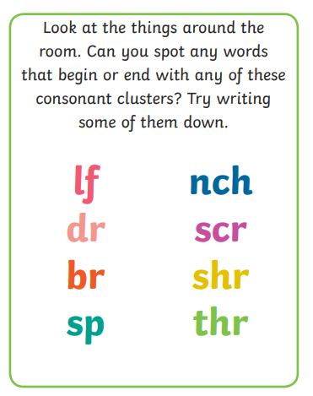
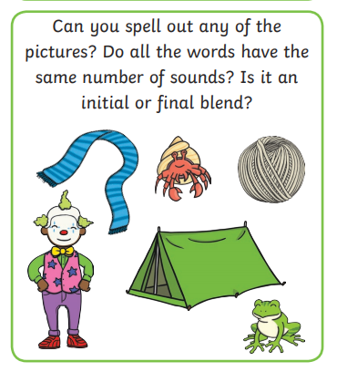
Phonics

Slide 32
Friday 24th April 2020

Slide 33
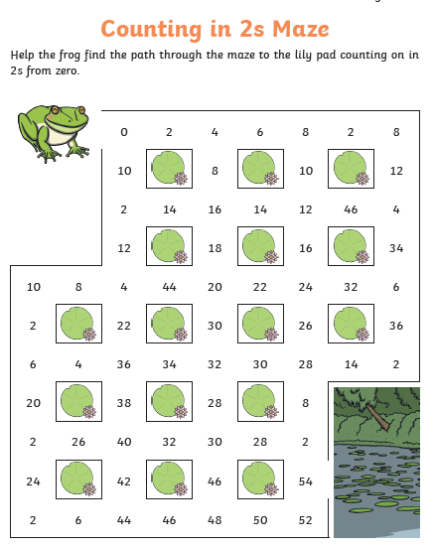

Slide 34
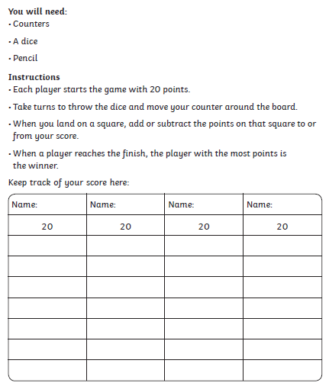
Play a game Friday!

Slide 35
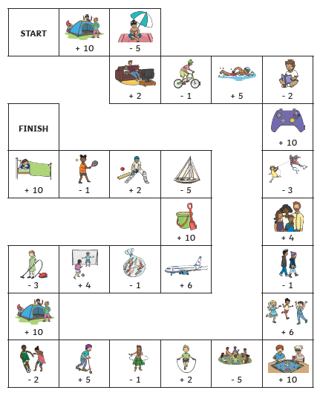
Play a game Friday!

Slide 36
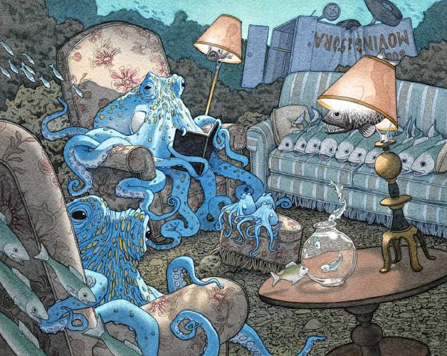
English
Using your books can you write a paragraph about this picture?
Remember: Capital letters and full stops.
Use adjectives (describing words) to make your sentences interesting.

Slide 37
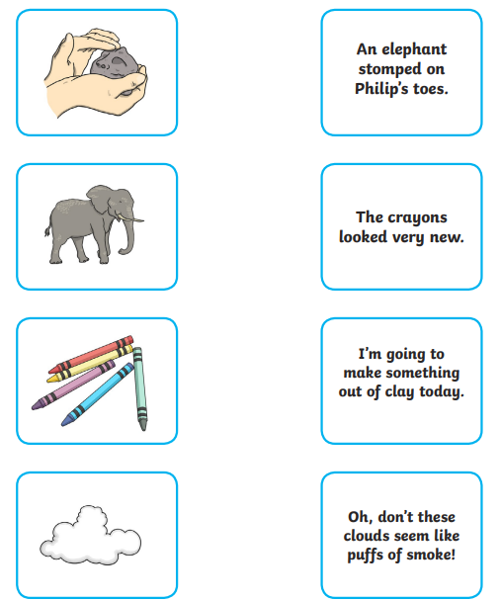
Phonics
Read the sentences and match them to the pictures/

