Slide 1
Revisit sounds
Can you sing the alphabet song? If an adult points to a letter along the alphabet line, can you give them the sound of the letter as well as the name?
Lesson 1
a b c d e f g h i j k l m n o p q r s t u v w x y z

Slide 2
What is this High Frequency Word/Tricky word?
you

Slide 3
this

Slide 4
that

Slide 5
igh

Slide 6
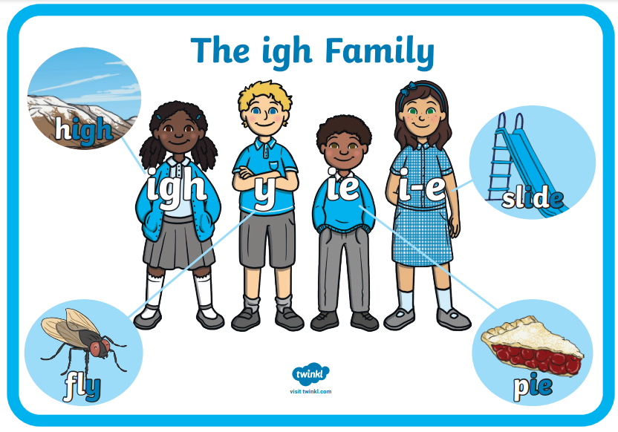

Slide 7
Let’s read these words together. Remember to use your robot arms to segment and then blend.
night

Slide 8
fright

Slide 9
right

Slide 10
Look at these words, you will be writing these but you cannot look at them and copy. I’ll cover them on the next slide.
night
fright
right

Slide 11
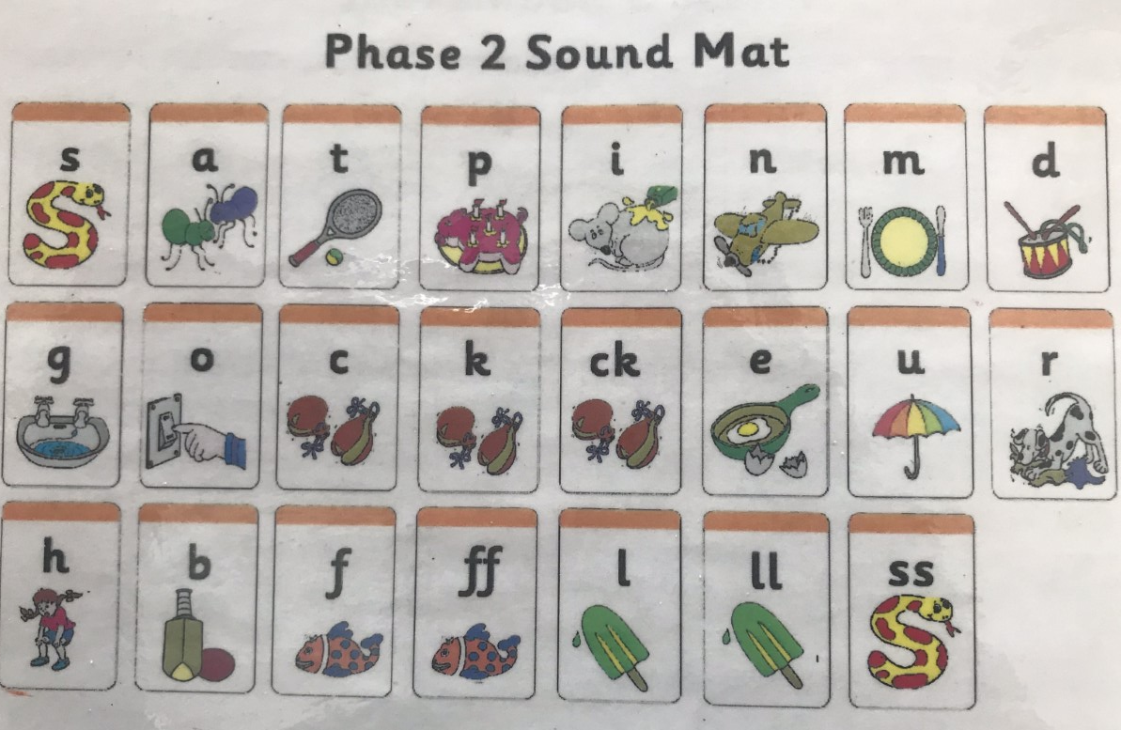
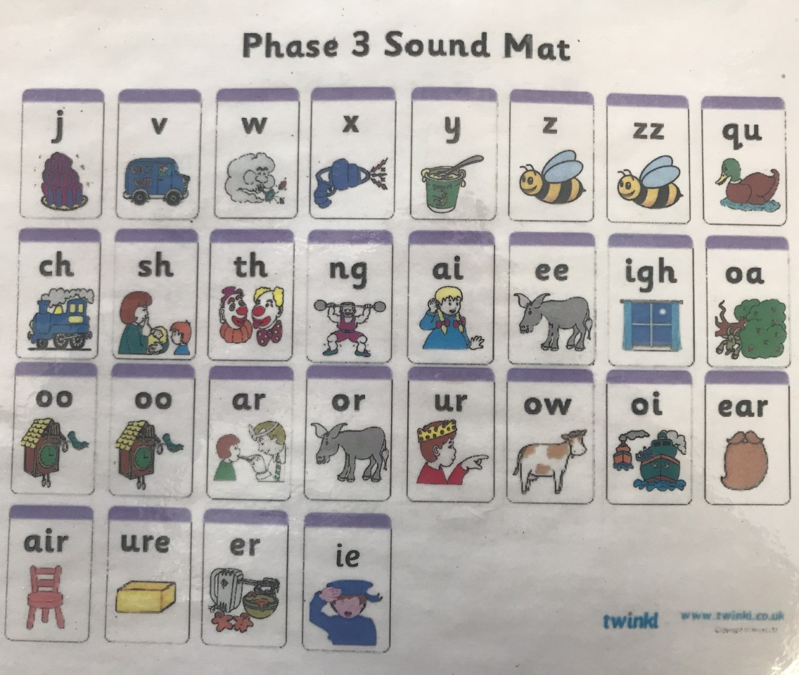
Write the three words using these sound matts if needed.

Slide 12
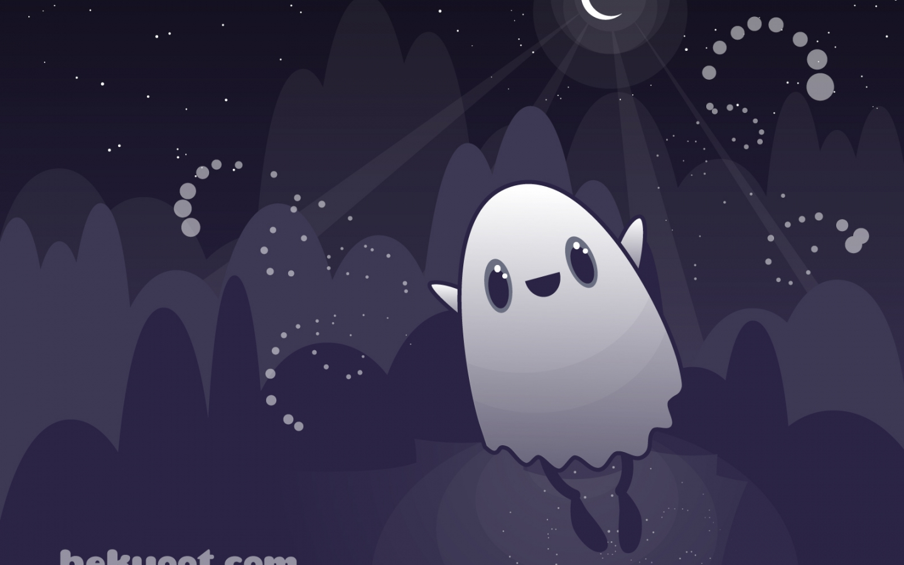
Write
I had a fright in the night!
Get your sentence fist out! Can you write this sentence (or one of your choice) without looking?

