Slide 1


Year 5
Virtual Learning Activities
January 2021
Week Beginning 25.01.21

Slide 2
Suggested format for completing your work:
Each time you open a new Guided Reading PowerPoint, please click:
File –
Save a copy online –
Type in your name, followed by ‘ – Alma’ and the short date
E.g. Roald Dahl - Alma 25.01.21
(This will enable you to edit the text and complete the activities)

Slide 3
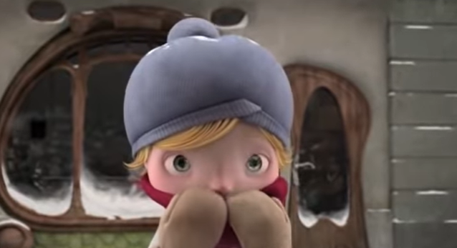
Alma
Autumn B – Guided Reading
Fiction Focus

Slide 4
2a: Give/explain the meaning of words in context | 2b: Retrieve and record information/identify key details from fiction and non-fiction. | 2c: Summarise main ideas from more than one paragraph | 2d: Make inferences from the text/explain and justify inferences with evidence from the text | 2e: Predict what might happen from details stated and implied | 2f: Identify/explain how information/narrative content is related and contributes to meaning as a whole. | 2g: Identify/explain how meaning is enhanced through choice of words and phrases. | 2h: Make comparisons within the text

Slide 5
Guided Reading
Sessions 8 & 9
Week Beginning 25.01.21
As we began studying this text in the Autumn term, the whole narrative (that you have read so far) can be found as an additional resource should you need to remind yourself of what has happened so far.

Slide 6
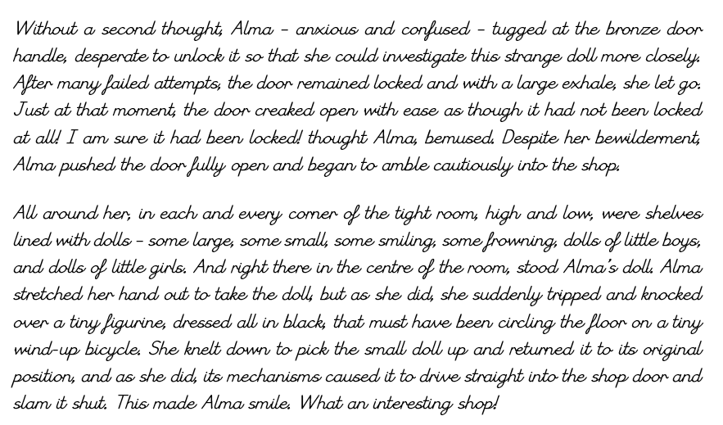

Slide 7
Trapped (Alma)
WALT: Summarise the main content from a text extract (2c)
On the following slide there will be space for you to complete the tasks.
Identify 5 words or sentences that you think add value to the story and explain why you have chosen them (2a)
Summarise this section of the text in no more than 100 words (2c)

Slide 8
Trapped (Alma)
WALT: Summarise the main content from a text extract (2c)
1.
2.

Slide 9
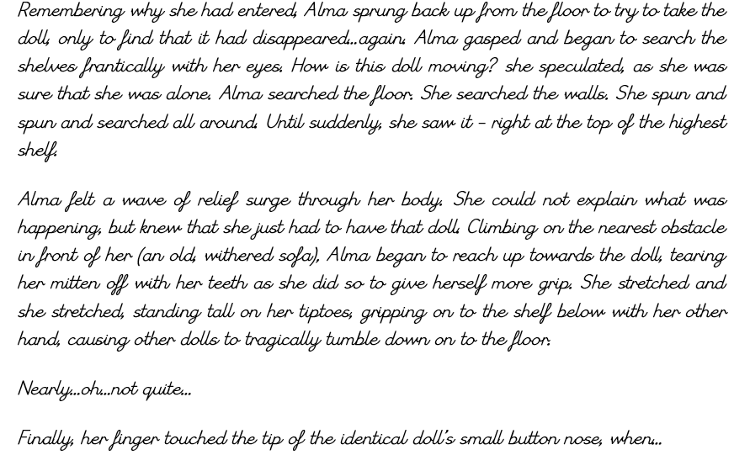

Slide 10
Trapped (Alma)
WALT: Identify/explain how information/narrative content is related and contributes to meaning as a whole. (2f)
On the following slide, answer the questions using evidence from the text:
Why do you think Alma wanted to touch the doll?
Can you link Alma touching the doll to Alma writing her name on the wall at the start of the story?
How does the layout of paragraphs encourage you to read on / find information?
What do you think will happen next?

Slide 11
Trapped (Alma)
WALT: Identify/explain how information/narrative content is related and contributes to meaning as a whole. (2f)
1.
2.
3.
4.

