Slide 1
19.01.21
WALT: use fractions when working out Ratio questions

Slide 2
DR ICE

Slide 3
DR ICE Answer

Slide 4
Recap from Monday’s lesson
Complete the sentence to describe the objects below.
There are _____________________ for every ____________________ .

Slide 5
Complete the sentence to describe the objects below.
There are 4 lightning bolts for every 3 squares.

Slide 6
Our learning for today
Match the fraction of circles to the correct set of objects.
2
5
2
8
3
6

Slide 7
Match the fraction of circles to the correct set of objects.
2
5
2
8
3
6

Slide 8
Let’s make it slightly harder
True or false?
If there are 3 bananas for every 5 peaches, of the fruit are peaches.
3
8

Slide 9
True or false?
If there are 3 bananas for every 5 peaches, of the fruit are peaches.
False, of the fruit are bananas.
3
8
3
8

Slide 10
Complete the sentence below if are squares and are circles.
There are ________ squares for every ________ circles.
4
9
3
9

Slide 11
Complete the sentence below if are squares and are circles.
There are 4 squares for every 3 circles.
4
9
3
9

Slide 12
Use the statement below to complete the bar model.
There are 6 squares for every 2 circles.
Write a fraction showing each quantity.
 | 2
=
=

Slide 13
Use the statement below to complete the bar model.
There are 6 squares for every 2 circles.
Write a fraction showing each quantity.
8
6 | 2
6
8
2
8
=
=

Slide 14
Gemma is making a bracelet using orange and blue beads.
Each bracelet contains 18 beads in total.
Write 5 pairs of fractions to show the possible ratio blue to orange beads.

Slide 15
Gemma is making a bracelet using orange and blue beads.
Each bracelet contains 18 beads in total.
Write 5 pairs of fractions to show the possible ratio blue to orange beads.
Various answers, for example:
blue beads and orange beads
11
18
7
18
© Classroom Secrets Limited 2019

Slide 16
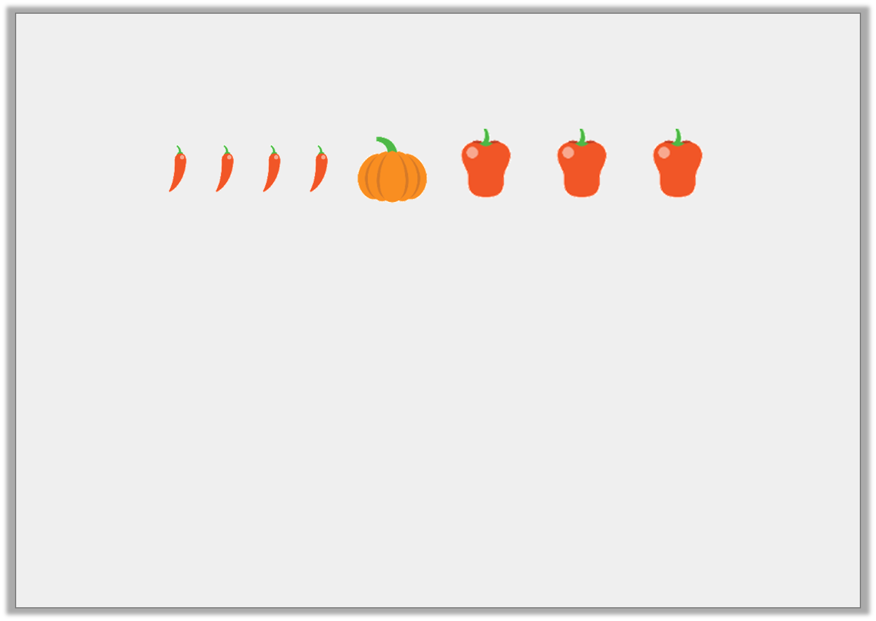
Which of the following statements match the image?
of the vegetables are pumpkins.
There are 3 chillies for every 4 peppers.
There are 8 items in total.
Explain how you know.
1
6

Slide 17
Which of the following statements match the image?
of the vegetables are pumpkins. False
There are 3 chillies for every 4 peppers. False
There are 8 items in total. True
Explain how you know.
Statement C because there are four chillies, one pumpkin and three peppers, which makes 8 in total.
1
6

Slide 18
Emma has a bag of 1p and 2p coins.
of the coins are 1p coins.
Emma says,
Nick says,
Who is correct? Explain how you know.
9
13
There are more 2p coins than 1p coins.
There are four 2p coins.

Slide 19
Emma has a bag of 1p and 2p coins.
of the coins are 1p coins.
Emma says,
Nick says,
Who is correct? Explain how you know.
Nick is correct because there are 13 coins in total and if there are nine 1p coins, there must be four 2p coins.
9
13
There are more 2p coins than 1p coins.
There are four 2p coins.

Slide 20
Ratio Vocabulary pattern ratio relationship for every true false

Slide 21
Fluency 1

Slide 22
Fluency 1 Answers

Slide 23
Fluency 2

Slide 24
Fluency 2 Answers

Slide 25
Reasoning

Slide 26
Reasoning Answers

Slide 27
Problem Solving

Slide 28
Problem Solving Answer

Slide 29
Challenge 1

Slide 30
Challenge 2

Slide 31
Challenge Answers

Slide 32
Plenary and self-assessment Can you write down 2 examples of when ratio fractions is used in real life? How did you feel at the beginning of the lesson (0-5) How do you feel now at the end of the lesson (0-5)

