Slide 1
Welcome to the Year 4
Information Meeting for Parents
Miss Younghusband, Mrs Skirvin and Mrs Madan
Mrs Freeman and Mrs Tahir

Slide 2
Organisation
Miss Younghusband is the class teacher for 4Y. Children in 4Y enter and leave school by the end door, facing the field.
Mrs Skirvin and Mrs Madan are the class teachers for 4SM. Mrs Skirvin teaches from Monday to Thursday and Mrs Madan teaches on Friday. Children in 4SM enter and leave school by the side door that is shared with Y3.
If there are occasions when your child will be collected by a different adult, please let us know.
Please help your child to bring the correct things with them to school. They need their reading book and water bottle every day.
Thank you to all of those parents who have named water bottles and school uniform. To avoid children losing items, we do recommend that everything is named.

Slide 3
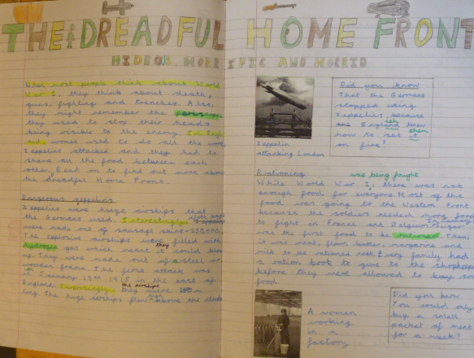
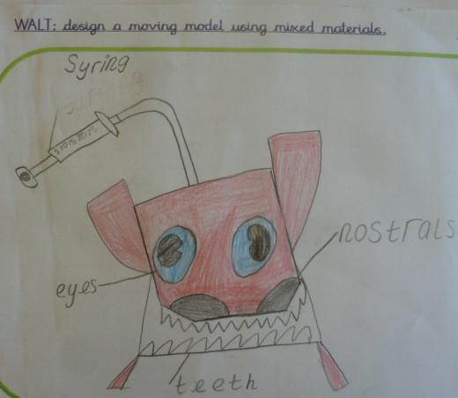
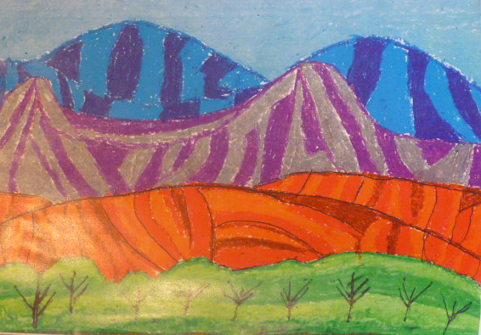
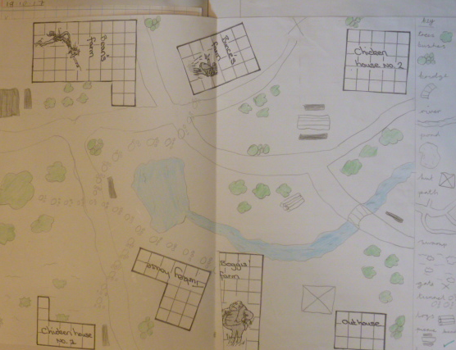
Topics in Year 4
Animal Magic
Mighty Mountains
Vicious Vikings
Flotsam
People, Posters and Peace
Brilliant Bodies

Slide 4
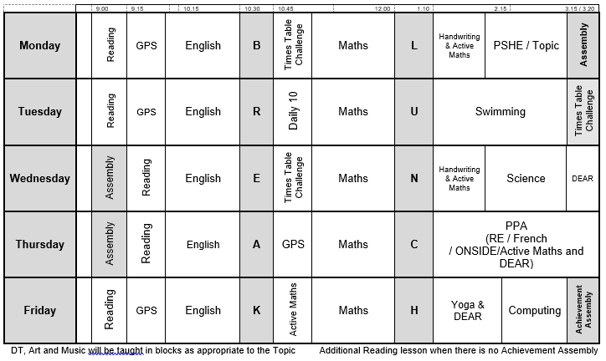
Year 4 Timetable

Slide 5




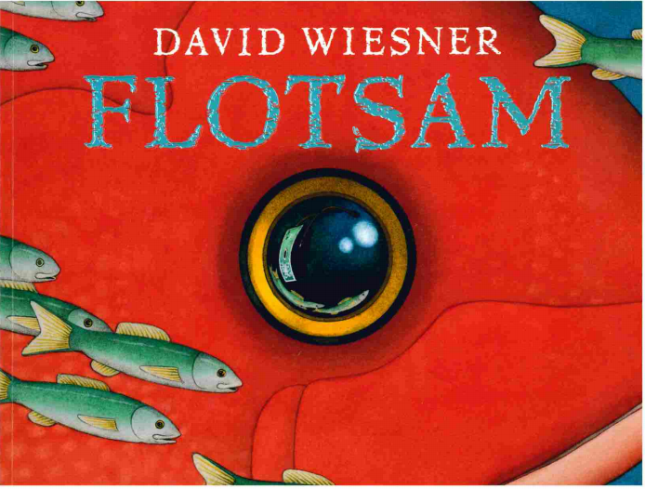
English
A variety of writing genres are taught, using exciting books as hooks to engage the children and as WAGOLLs to share examples of high quality writing.

Slide 6

Reading
For the majority of children, reading is taught as whole class lessons using a book that links closely to the half term’s topic.
In Year 4, there is an increased focus on comprehension and understanding of events within texts. They will also make inferences from texts and broaden their knowledge and understanding of a wide variety of more advanced vocabulary.

Slide 7
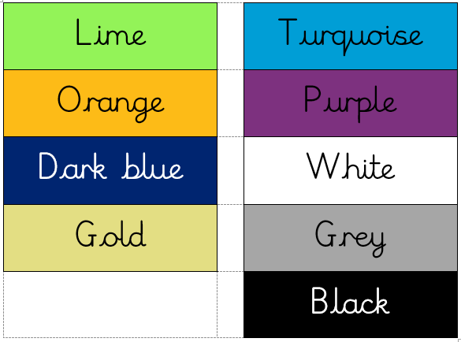
Accelerated Reader
In school, the children choose independent reading books from appropriate colour bands in Accelerated Reader, according to their results on a computerised reading test. The colour(s) allow each child to choose books at an appropriate level for their stage of reading development. As well as reading their Accelerated Reader books at school, the children are also encouraged to take these books home to either read with you or to read independently.

Slide 8
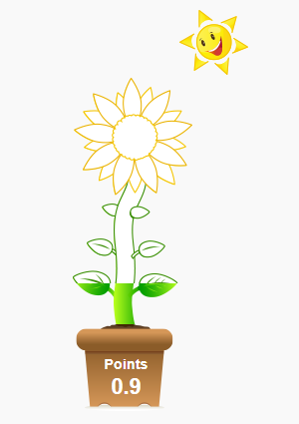
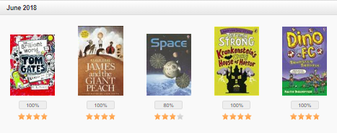
More about Accelerated Reader
When an Accelerated Reader book has been finished, the children then take a quiz at school which tests their comprehension and understanding of the book. They receive a score for each quiz and when they pass a quiz, they receive points.
During the year, children are aiming to achieve an average quiz score of 85%.

Slide 9

Individual Reading
In school, children also read individually with an adult, either on a regular or an occasional basis.
If you are able to come into school to listen to some children reading, please do let us know. Your help with this would be greatly appreciated.

Slide 10
Home Reading
Regular reading at home will help your child to make good progress. It is recommended that children read at least four times a week at home, for about 15 minutes on each occasion.
You can help your child by modelling good reading, discussing what has happened in the texts they read and helping them to understand new vocabulary.

Slide 11
Parents and Accelerated Reader
Home Connect https://ukhosted64.renlearn.co.uk/2249453/HomeConnect/
You can log into this web page to see which books your child has read and how they are doing in their quizzes.

Slide 12
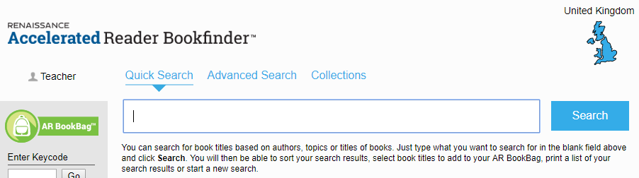
Home Reading Books
We are happy for children to bring books from home into school if there is a particular book that they would like to read. If possible, please write their name inside the book so that it does not get mistaken for a school book.
You can check whether your child’s home books are part of the Accelerated Reader scheme using the following website:
www.arbookfind.co.uk

Slide 13
Spellings
The majority of children will be learning to spell the 109 Year 3 and 4 words.
By the end of the year, the Year 4 target is for the children to spell 80% of these words (87) correctly.
The children will practise these words at school, but practising 5 words every week at home will help your child to achieve their target. These words will not be tested on a weekly basis. Instead, the Year 3 and 4 words will all be retested towards the end of each term.
You will find a copy of the appropriate list for your child at the back of their homework book so that you are aware of which words they still need to practise. For children who have practised the remaining Year 3 and 4 words that they spelt incorrectly in the recent test, the Year 5 and 6 words list will be made available.

Slide 14
Handwriting
In Year 4, the children will continue to practise their handwriting using the Letterjoin style of cursive writing.
At home, you can access Letterjoin on an ipad or tablet. To do this, search for Letter-join. http://www.letterjoin.co.uk
You will need to select the Tablet button at the top of the home page and use the following log in details:
user name: lj0659
Your swipe code is set as a capital `L` shape, starting at the top left:
O
O
O O O

Slide 15
Maths
Maths is taught through the 6-part Maths lesson which involves three different levels of independent activities:
Fluency – for the children to practise the basic skills
Reasoning – where the children apply their skills to help them secure their knowledge
and Problem Solving – where the children solve a variety of interesting problems which help them to deepen their understanding

Slide 16
Times Tables
In Year 4, the children need to learn ALL of the times tables up to 12 x 12 and the related division facts. The aim is for the children to know the answers instantly. Nationally, all children in Year 4 will be assessed on their times table knowledge near to the end of the school year.
In school, the children will practise times tables in a variety of ways, including during Active Maths, by playing times tables games or ipad games and by completing Times Table Checkpoint Challenge sheets. They will bring their Checkpoint Challenge sheets home to share with you so that you can see how they are progressing and help them to practise particular facts they are struggling with.
Games and songs are effective ways of practising times tables whilst the children are having fun.

Slide 17
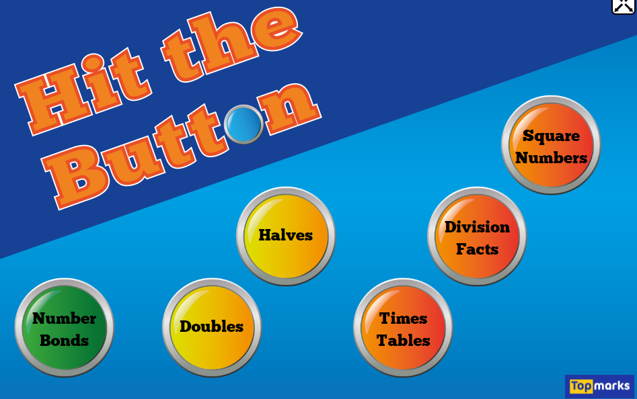
Hit the Button
This is a great on-line game that can be used to help the children practise tables facts, division facts etc.
You can find it by searching for:
Hit the Button
https://www.topmarks.co.uk/maths-games/hit-the-button

Slide 18
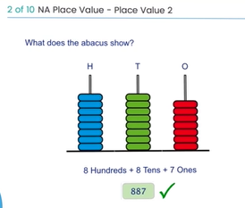
Mathletics
All children have a Mathletics log-in and they are encouraged to use Mathletics regularly at home.
Currently details are being updated. If you need help with Mathletics, please let us know.

Slide 19
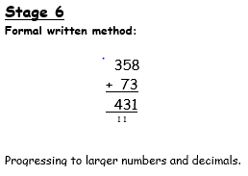
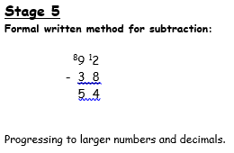
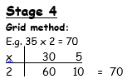
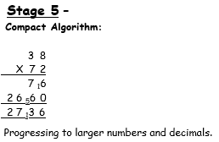
Written Methods
In Year 4, the children will use formal written methods for addition, subtraction and multiplication. Written division is also introduced later in the year.
If you would like to know more about the written methods used in school, the Woodloes Primary School’s Calculation Policy is available on the website in the What’s Going On, Year 4 section.

Slide 20
PE and Swimming
Year 4 children are currently having swimming lessons on Tuesday afternoons at St. Nicholas Park pool. These will continue for the whole of the Autumn term until just before Christmas. All jewellery should be removed for swimming lessons and left at home.
PE will be taught by both Onside and school staff. Onside lessons will be alternate half terms on a Thursday afternoon. Class PE lessons will be on a Friday. Please ensure that your child has their PE kit in school for all PE lessons. Jewellery should not be worn for PE lessons.

Slide 21
Homework – Little and Often
Every half term, homework tasks linked to the topic will be set. There is always a choice so that your child can choose something that they are interested in.
Please also try to complete the other ongoing homework on a regular basis:
Reading – 4 x weekly
Spellings – practise 5 words a week
Times tables – Hit the Button, songs, games, quick questions
Mathletics

Slide 22
Local Area Visits
To enhance curriculum delivery and encourage personal development, we may take the children on out on local area visits.
These will be:
Within short walking distance from school
Staffed according to Warwickshire guidelines
Incur no cost
Always fall within the normal school hours
We will not seek consent for each local area visit but will send a courtesy note (when possible) to inform you in advance that one is planned.

Slide 23

Thank you for your support and help!
Any questions?

