Slide 1

Year 5
Virtual Learning Activities
January 2021
Week Beginning 11.01.21

Slide 2
Suggested format for completing your work:
Each time you open a new English PowerPoint, please check the format that we would like you to save your work as.
For this week’s learning, if you wish to submit your work online, you can save a copy of the PowerPoint following the instructions below. This will enable you to edit the document and type your work straight into the PowerPoint.
File –
Save a copy online –
Type in your name, followed by ‘ – English’ and the short date
E.g. Brian Selznick - English 05.01.21
Alternatively, you can type your work into a document using Microsoft Word (accessed from your welearn365 account), or work on paper and upload a photograph/scanned copy of your work into a Microsoft Word document. There is no expectation for you to share your work with us but we love to see how you are getting on.

Slide 3


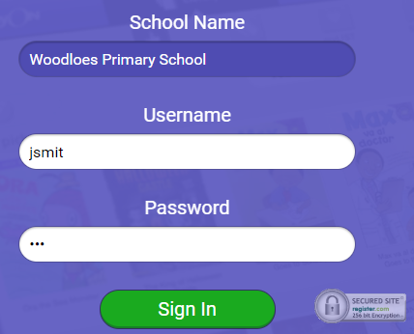
Reading
Please remember the importance of reading for pleasure in addition to your set English and weekly Guided Reading activities.
You can still access Accelerated Reader at home during school hours (to quiz, check your reading level etc.) by following the link: https://ukhosted64.renlearn.co.uk/2249453/
You can also use MYON reading books https://www.myon.co.uk/login/index.html to access digital texts. To login to this website, select ‘Woodloes Primary School’ as your educational setting, use your first initial followed by the first four letters of your last name, and type in the password ‘ABC’.
  e.g. John Smith - jsmit

Slide 4

WALT: Use our inference skills to make predictions about the text.
Monday 11th January 2021

Slide 5
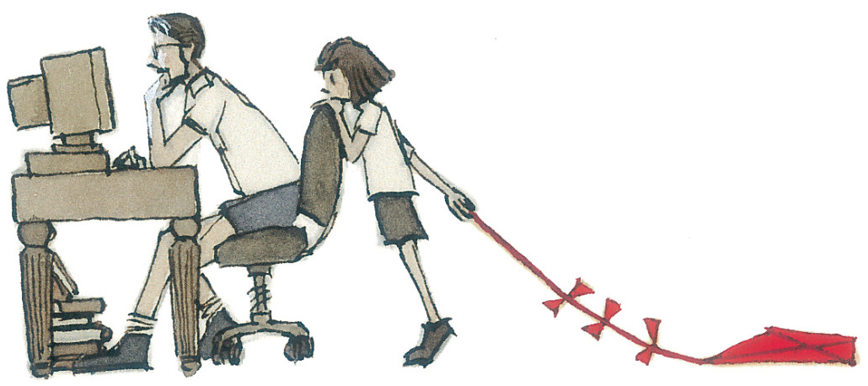
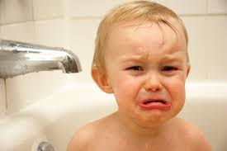
Inference
What does the word ‘inference’ mean?
What can we infer from this illustration?
It is important to support your claim with evidence. For example:
  I think that the girl is upset and maybe a little frustrated. She clearly wants company to go and fly her kite and so she is leaning on the back of the chair impatiently. We can assume that this may be her father and he looks very busy on the computer because he is concentrating on the screen with lots of books underneath his desk.
Now it’s your turn… have a go at writing down what you can infer from this photograph. Remember to support it with evidence.

Slide 6

Activity
Look at the image below (it is the front cover from our new text) and think about what we can infer about the story.
Consider and record down on paper:
  Possible title
  Possible storyline
  Characters
  Genre
  Setting

Slide 7
Activity
In full sentences, we would now like you to record your predictions, remembering to support your inferences with evidence from the picture.
You may wish to use some of the openers below:
By looking at the illustration, I think that…
I predict that… because…
Based on my prior knowledge of…. I would imagine that….
After studying the image, my impression would be…

Slide 8
Once you have saved a copy of the PowerPoint feel free to edit this slide and type in your work.

Slide 9
WALT: Generate simple, compound and complex sentences
Tuesday 12th January 2021

Slide 10
What is a simple sentence?
A simple sentence is a group of words that expresses one complete thought. Every simple sentence must contain a subject and a verb. They can also be called a main or independent clause.
Can you spot the subjects and the verbs in these main/independent clauses?
Samira likes football.
Samira likes football.
Samira likes football.
subject
verb
Ben loves basketball.
Ben loves basketball.
Ben loves basketball.

Slide 11



What is a compound sentence?
Both of these main/independent clauses make sense on their own.
Samira likes football.
Ben loves basketball.
and
When we link them together with a co-ordinating conjunction, they form a compound sentence.

Slide 12
There are seven co-ordinating conjunctions that we can remember using the mnemonic ‘FANBOYS’.
for
and
nor
but
or
yet
so
Samira likes football.
?
Ben loves basketball.
Which other co-ordinating conjunctions could be used to link these two main/independent clauses?

Slide 13
What is a complex sentence?
A complex sentence is made up of a main clause and then
one or more dependent clauses.
There are two ways of creating dependent clauses:
by using a subordinating conjunction (e.g. after) to create a subordinate clause, e.g.
The horse galloped after it jumped the fence.
by adding extra information using a relative clause.
Mr Richardson, who was feeling ravenous, ate some cheese.

Slide 14
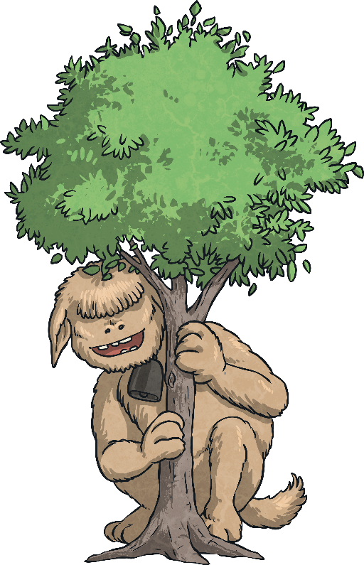
Firstly, let’s look at creating complex sentences by using subordinate clauses that begin with a subordinating conjunction.
I
S
A
W
A
W
A
B
U
B
is an acronym to help you remember the first letters of some of the most important subordinating conjunctions.
If
Since
As
When
Although
While
After
Before
Until
Because

Slide 15

Can you spot the subordinate clause and the subordinating conjunction in this complex sentence?
The boy scouts sang around
the campfire until it was time
for bed.
The boy scouts sang around
the campfire until it was time
for bed.
I SAW A WABUB!

Slide 16
Can you spot the subordinate clause and the subordinating conjunction in this complex sentence?
Hakim could win the talent contest if he improved his juggling skills.
Hakim could win the talent contest if he improved his juggling skills.
I SAW A WABUB!

Slide 17
In the complex sentences we have looked at so far, the subordinate clause has always come after the main clause but watch…
Although their feathers aren’t yet waterproof, juvenile penguins are able to swim.
Juvenile penguins are able to swim although their feathers aren’t yet waterproof.
I SAW A WABUB!

Slide 18
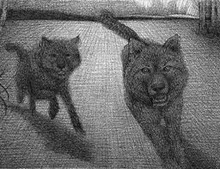
Now it’s your turn…
Simple (main clause containing a subject and verb)
e.g.
The wolves fled further into the darkness.

Slide 19
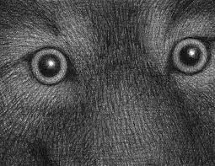
Now it’s your turn…
Compound (coordinating conjunctions – fanboys)
e.g.
The mist was spreading through the forest yet the wolves’ eyes glowed red with anger.

Slide 20
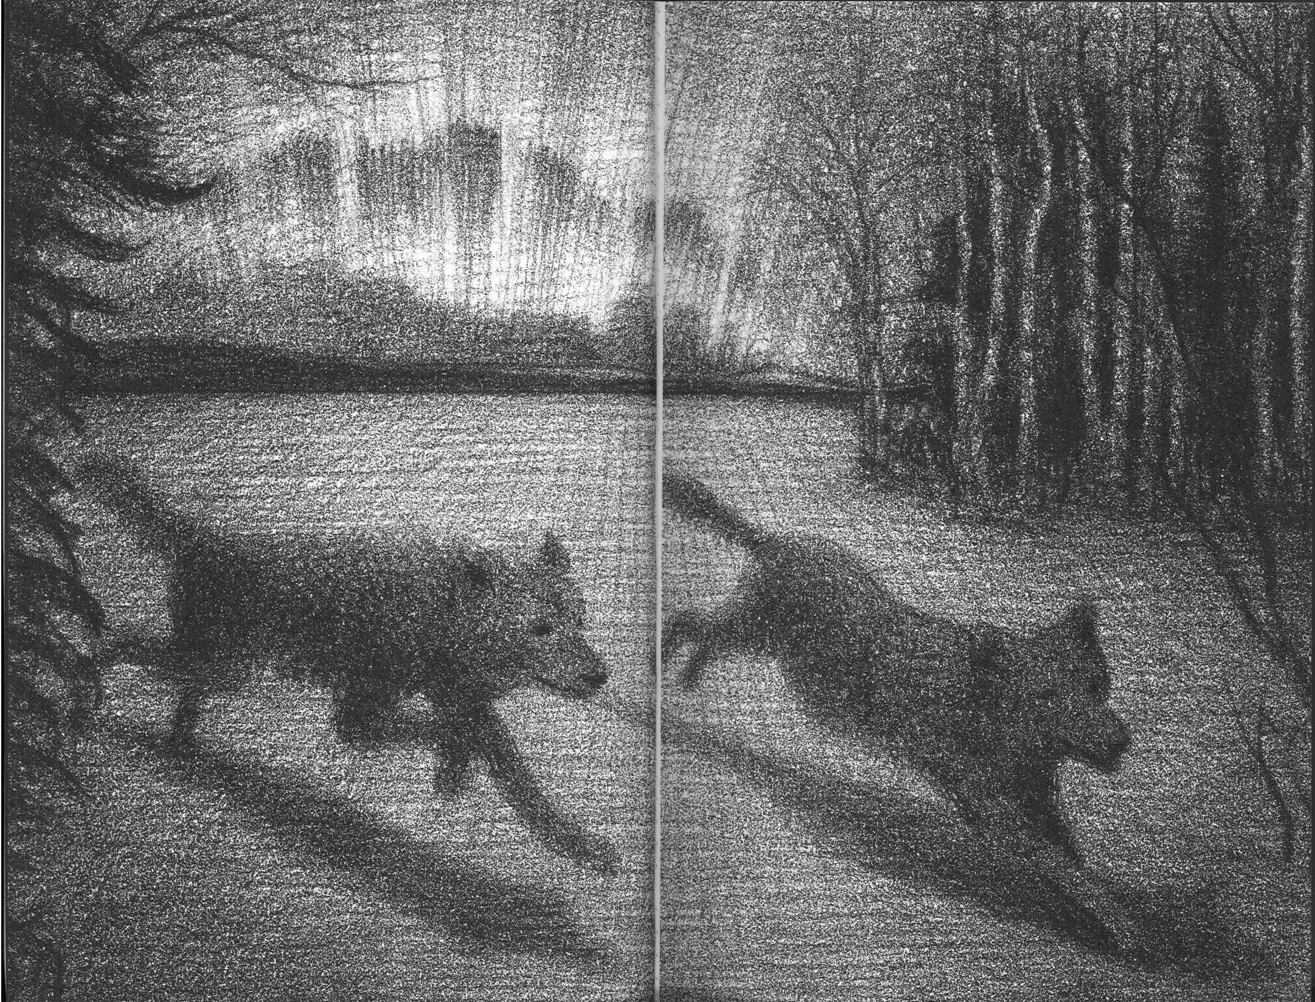
Now it’s your turn…
Complex (subordinating – isawawabub)
e.g.
Although the moon sat watching from above, the mysterious creatures scavenged below.

Slide 21
Once you have saved a copy of the PowerPoint feel free to edit this slide and type in your work.
Try to write at least one simple, compound and complex sentence about the images (to the right).

Slide 22
WALT: Create a sense of anticipation in our writing
Wednesday 13th January 2021

Slide 23
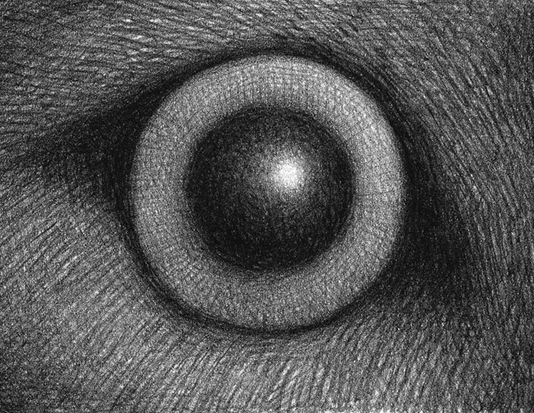
Today will be a continuation of yesterday’s lesson, but with an emphasis on creating a sense of anticipation
Anticipation:
a feeling of excitement about something that is going to happen in the near future
When you are generating your sentences today, we would like you to consider your audience. You want the reader to want to read on - so make them as interesting as you can!

Slide 24
Today will be a continuation of yesterday’s lesson, but with an emphasis on creating a sense of anticipation
Using the four images below, consider all of the different ways that they could be sequenced to create a brief story opening.
Have a go at rearranging the order of the sequence… how many different scenarios can you create?
Can you write a simple, compound or complex sentence to link two of them together?
1.
2.
3.
4.

Slide 25
Today will be a continuation of yesterday’s lesson, but with an emphasis on creating a sense of anticipation
Decide on your final sequence and (using simple, compound and complex sentences) record your final sequence in your book by writing a mini introduction to the story.
Remember you want the reader to want to read on so make them interesting.
CHALLENGE: Can you include any sentence types in your introduction?

Slide 26
Once you have saved a copy of the PowerPoint feel free to edit this slide and type in your work.

Slide 27
Opportunity to share writing from yesterday’s lesson.
Thursday 14th January 2021

Slide 28
Thursday 14th January 2021
As the English lessons are live this week, we would like to take this opportunity to share some of your work with your peers.
Please remember to be respectful at all times.
Can you spot some of the features that we have been focusing on this week?
Perhaps you would like to have a pencil and paper nearby so that you could provide feedback to a friend - what did you like about their introduction, what could they to do improve it?
You are under no pressure to share your work, but remember that this is a safe place to do so and that even if you decide not to, your comments could be extremely valuable to somebody else's work.
For the remainder of this session, you may wish to edit a section of your introduction or even rewrite it, considering any feedback that may have been shared.

Slide 29
WALT: Use our inference skills to analyse a text. (Reading link)
Friday 15th January 2021

Slide 30
WALT: Use our inference skills to analyse a text. (Reading link)
Today, we are going to read through an extract of our new text as a class.
Using our inference skills, we are going to try and work out what we think has happened so far.
What evidence do we have to support your theories?

Slide 31
WALT: Use our inference skills to analyse a text. (Reading link)
Something hit Ben Wilson and he opened his eyes. The wolves had been chasing him and his heart was pounding. He sat up in the dark room and rubbed his arm. He picked up the shoe that his cousin had thrown at him and dropped it on the floor.
What inferences can you make from this extract of text? Make sure you use evidence from the text to justify your inferences.
Are there any points that you would require further clarification?
Write out the extract above and create a key to identify what you are able to infer.

Slide 32

Example of how to present your work
Something hit Ben Wilson and he opened his eyes. The wolves had been chasing him and his heart was pounding. He sat up in the dark room and rubbed his arm. He picked up the shoe that his cousin had thrown at him and dropped it on the floor.
** Ben had been woken up
** He had been running fast
** He had hurt his arm
** His cousin was with him
Re-write this paragraph to give the same information but in a different way..
☺ Based on the text that I have read so far, I predict that the text will be a _____ genre about ________.
We have not directly been told any of these facts, but we can infer them from the text

Slide 33
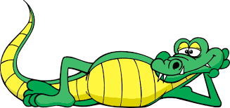
Thank you and well done!
We hope you have enjoyed the live English lessons this week.
Well done for working hard, now it’s time to chill!
Have a happy and healthy weekend and we will see you again next week!

