Slide 1
Life in Year 1

Slide 2

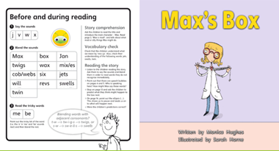
PE sessions are on a Thursday and are currently with Mr Mitchell in the forest.
Please label ALL CLOTHES (just biro is fine), and jumpers, then as they get ‘lost’ we can get them back to you.
Reading books can be changed on a daily basis but we are encouraging you all to use phonics bug at the moment as it is a super safe way to access the phonics books and the children really enjoy reading the books on a tablet just remember to click the bug logo at the beginning and end of the book as this logs that your child has read the book on our system and we can monitor how your child is doing.

Slide 3
Our School Year
Autumn Term
We will build on the children’s learning experience in Reception and provide their learning through play with small focus groups for teacher input. Guided Reading, Phonics and Handwriting are taught daily as are maths and English. During the pm when the children are learning through play, we are working on a ‘catch up’ intervention timetable for group work.
As you know the children are sat at tables facing forwards (as per guidelines) so the pm play is more important than ever!
Normally we would move away from continuous provision by the end of the Autumn term, HOWEVER this year we will base this on the needs of each class taking into consideration their mental well being.

Slide 4
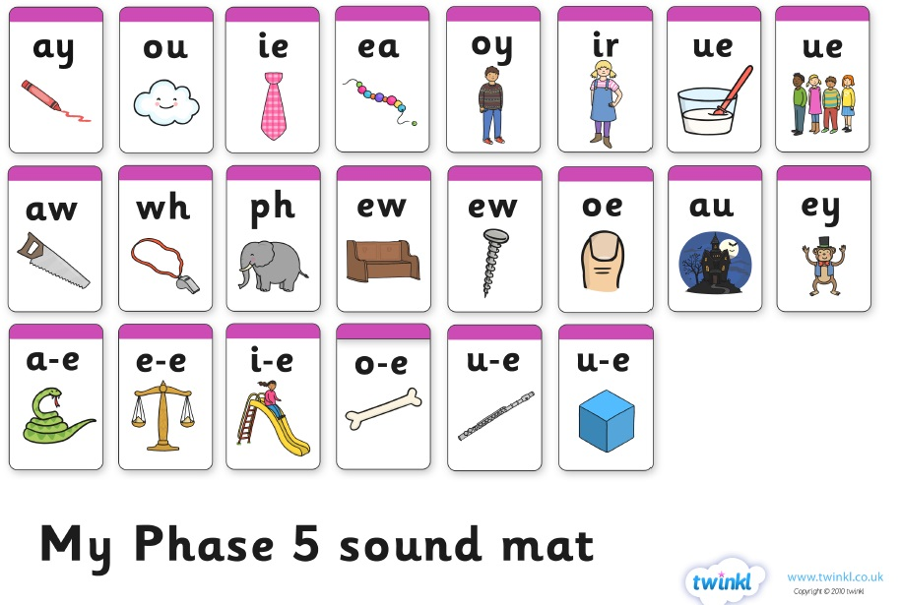
Phonics
Phoneme – smallest unit of sound which make up a word. There are three phonemes in sit /s/-/i/-/t/
Grapheme – written representations of sound
Digraph – two letters making one sound e.g. ch, th, sh, ph.
Trigraph – a sound consisting of three letters e.g. igh.
Children need to blend phonemes (sounds) to read and segment words (split it into sounds) to write.
We are currently recapping phase 3 to regain confidence and encouraging the children to use phonics to spell as well as read.Then we will move through phase 4 and phase 5 at the pace of the cohort.

Slide 5
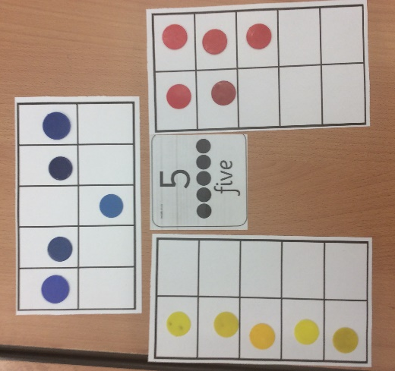
Maths Mastery
Based on Singapore Maths
More in depth offering better foundations for the primary journey of maths
More emphasis on language and vocabulary – talking about what the children know and how they know it.
Problem solving not just calculating.

Slide 6

Ways that you can help your child…

Slide 7

How you can help your child with reading…
Read regularly with and to your child. Your child cannot access learning without being able to read.
Talk about what you’ve read and ask them questions.
Share the reading.
Help your child to learn the phonemes and tricky words.
Encourage a love for reading. let your child see you read and have different types of reading material around the house, books, magazines, newspapers.

Slide 8


How you can help your child with handwriting…
Encourage them to hold their pencil correctly and form the letters properly.
Recognise and write capital letters.
Check ascenders (letters above the line) and descenders (letters below the line). See the website Year 1 page for examples of pre cursive handwriting.

Slide 9
How you can help your child with writing…
Phonics breaking words down into phonemes (units of sound).
Ask the children to tell you about their experiences. Always encourage them to talk using full sentences.
Find opportunities for the children to write for a purpose. Shopping lists, postcards, labels.
Let the children see you writing for different purposes.

Slide 10
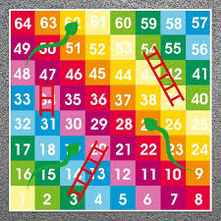
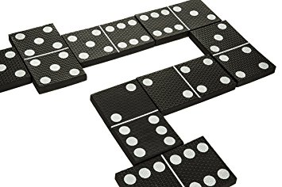

How you can help your child with Maths…
Play board games like dominoes, snakes and ladders, ludo, any dice games and simple card games. Not only does this reinforce counting it promotes turn taking and talking too!
Discuss odd and even numbers.
Use language like, “What is one more than..? What is one less than…? Encourage your child to use full sentences at all times.
Practise number bonds within 10 (over and over!)

