Slide 1
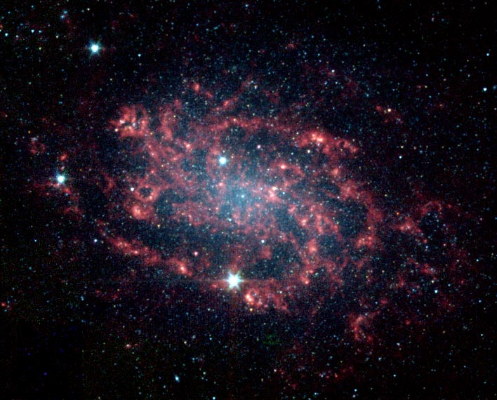
Space

Slide 2
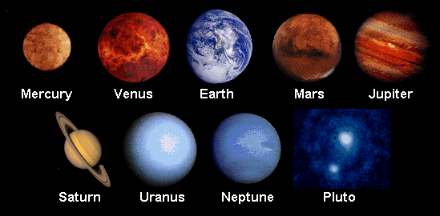
In space there are lots of planets. We live on a planet called Earth. Do you know the names of any other planets?

Slide 3
There are millions of stars in space. They are huge but because they are so far away they look tiny to people on Earth. We see them twinkling in the night sky.

Slide 4
Lots of planets and stars make up a galaxy. All the coloured dots are planets and stars.

Slide 5
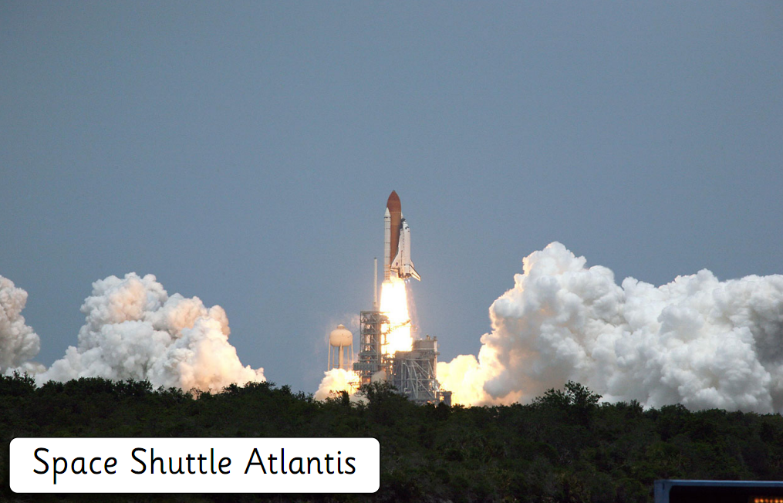
There are lots of people who want to find out more about space. They send space shuttles into space to learn more about the planets and stars.
10, 9, 8, 7, 6, 5, 4, 3, 2, 1 BLAST OFF!!!!!!

Slide 6
The special people who fly the space shuttles are called astronauts.
What is this astronaut doing?

Slide 7
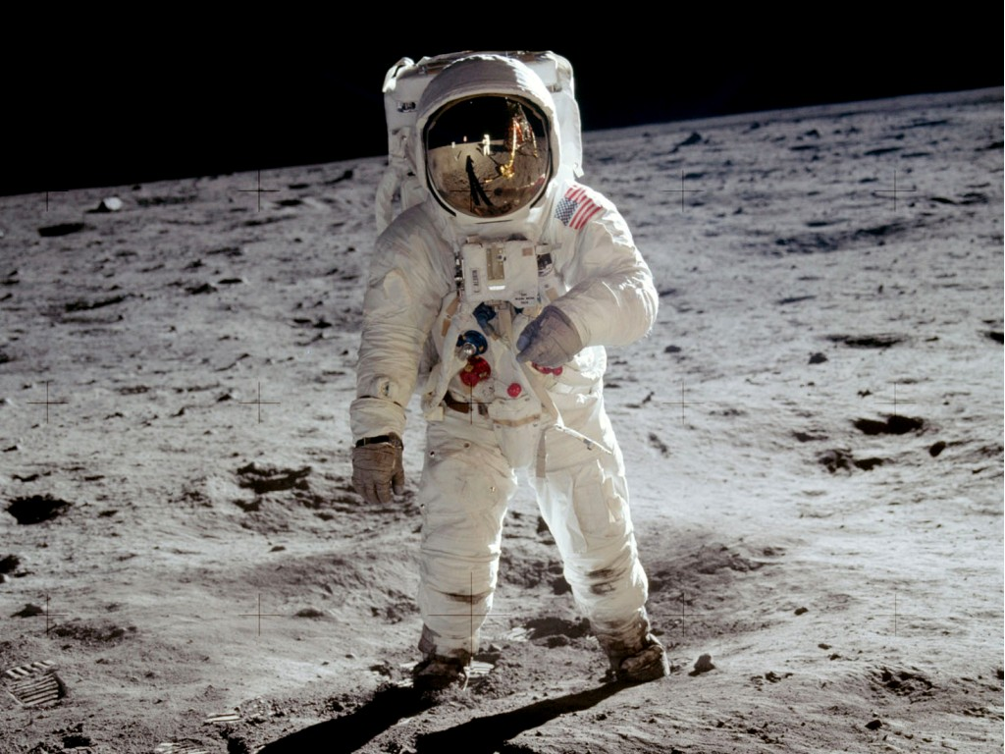
Astronauts need to wear special clothes when they fly into space.
air pack
helmet
gloves
space boots
How do the special clothes help the astronaut?

